Slide 1
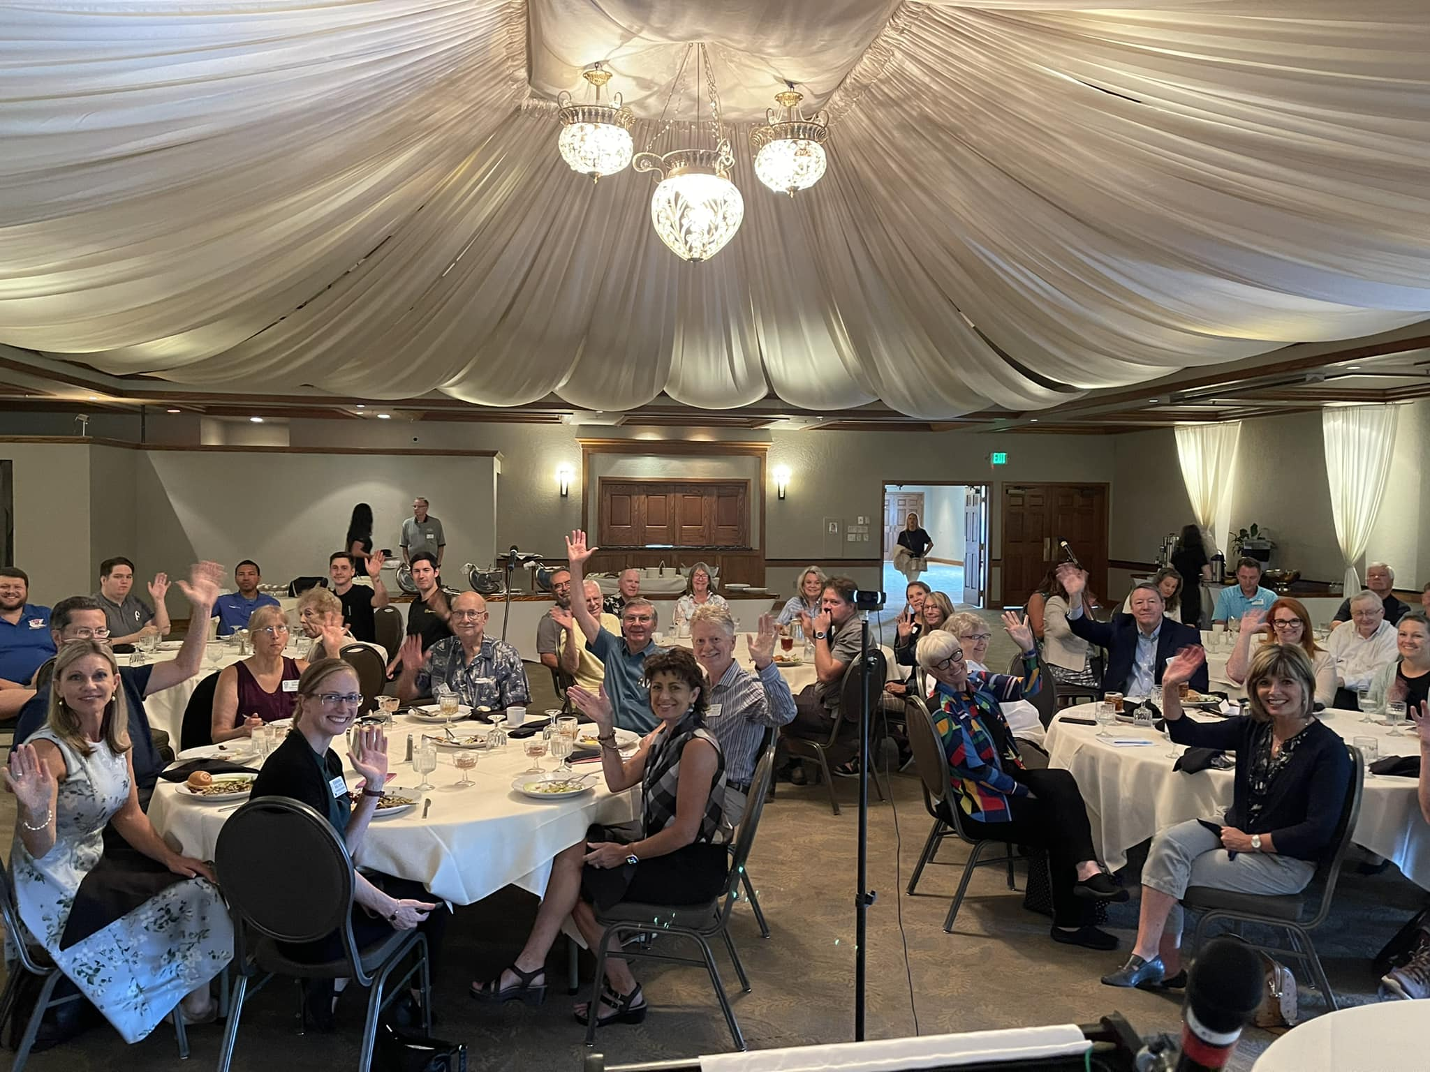
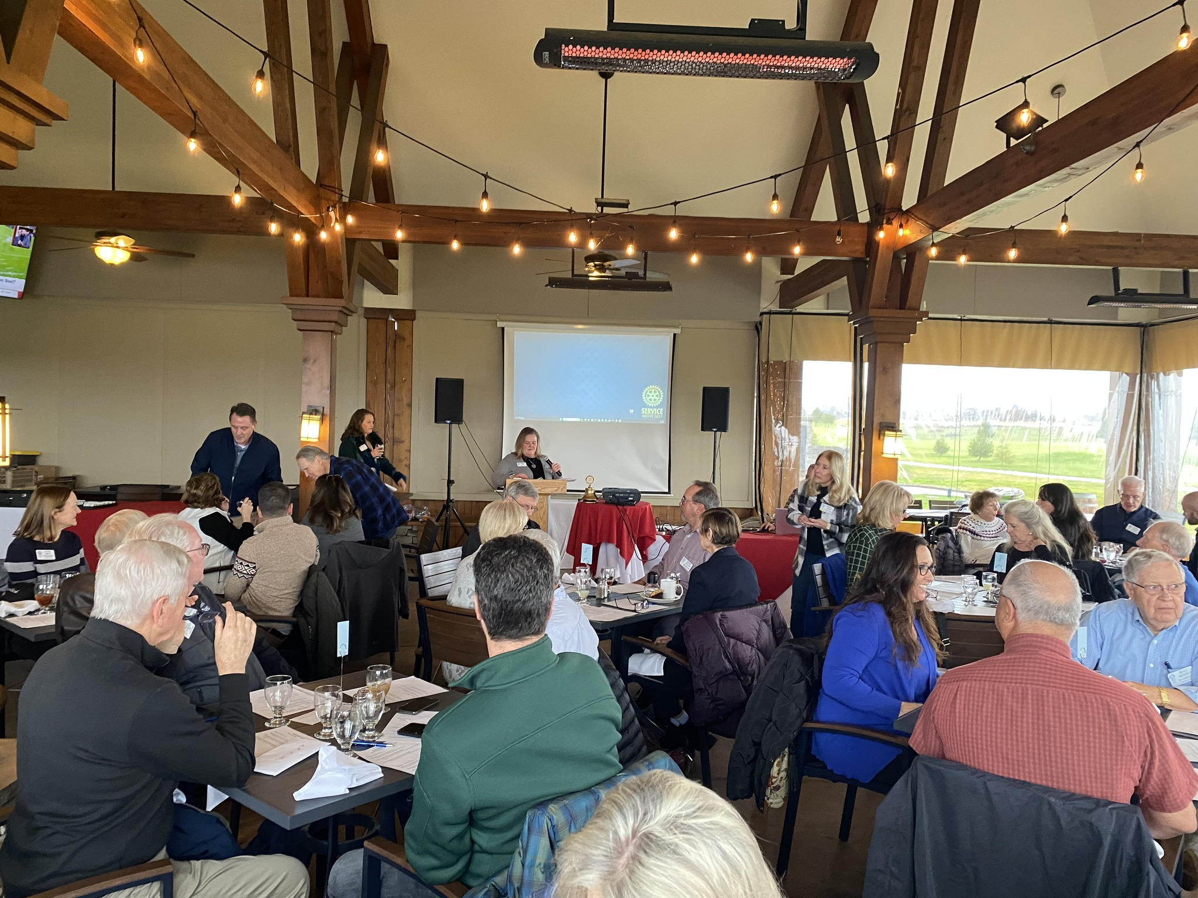
2023-2024
Year In Review
Notes:
Today’s meeting is a farewell from me, as the new Rotary year begins and we pass the gavel to President Elect Rachel Torres. This year’s theme was “Create Hope in the World”. So, as my goodbye I want to not only give you the “year in review” but also highlight how we, as members of MRR, personified this years theme.

Slide 2
$24,450 raised for Rotary International Annual Fund
$4,139 raised for Polio Plus
$2,685 raised for Maui’s Fire Relief
Sergeant’s
3 year plan completed with goals and actions for 2024
Engaged membership reflecting the community we serve
Well branded signature events
Well defined menu of projects and services
Financial efficiency and sustainability
Strategic Plan
New Facebook page
Updated website
New Communicator tied to website
Communications
Notes:
So, first the business The Board completed . . . Strategic Plan = priorities

Slide 3
Rotary Club of Medford Rogue 2023-24 July - May | Actual | Budget
Revenue Club Receipts | 8,7220.88 | 77,950.00
Expenses Meetings | 3,115.25 | 36,280.00
Committees | 5,555.00 | 3,900.00
Youth | 8,631.68 | 14,490.00
Officers/Board | 5,457.04 | 11,100.00
Club Admin | 4,510.35 | 3,975.00
RI & District | 19,207.00 | 19,276.00
Candyland | 19,249.68 | 20,000.00
Carry Forward | 10,000.00 | 10,000.00
Club Investment Interest | 1,829.55 | 3,365.00
Net Revenue | 12,754.56 | <11,181.00>
Notes:
Deficit -> surplus

Slide 4
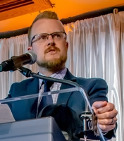
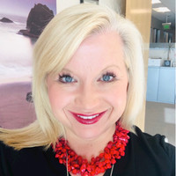
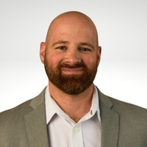
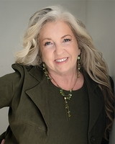
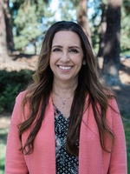
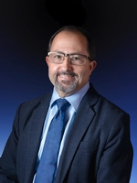
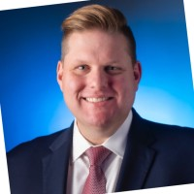
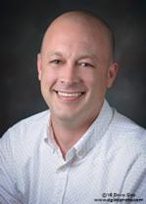
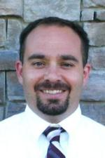
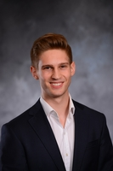
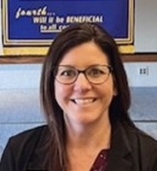
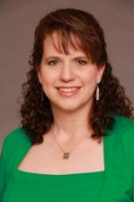
New Members
12 new members inducted:
Cooper Whitman
Laura Hansen
Steve Miller
Fawnda Shahalami
Angela Durant
Randy Sparacino
David Sommers
Kurt Hildebrand
Jay Harland
Jessica King
Tisha Oehman
Jonah Liden

Slide 5
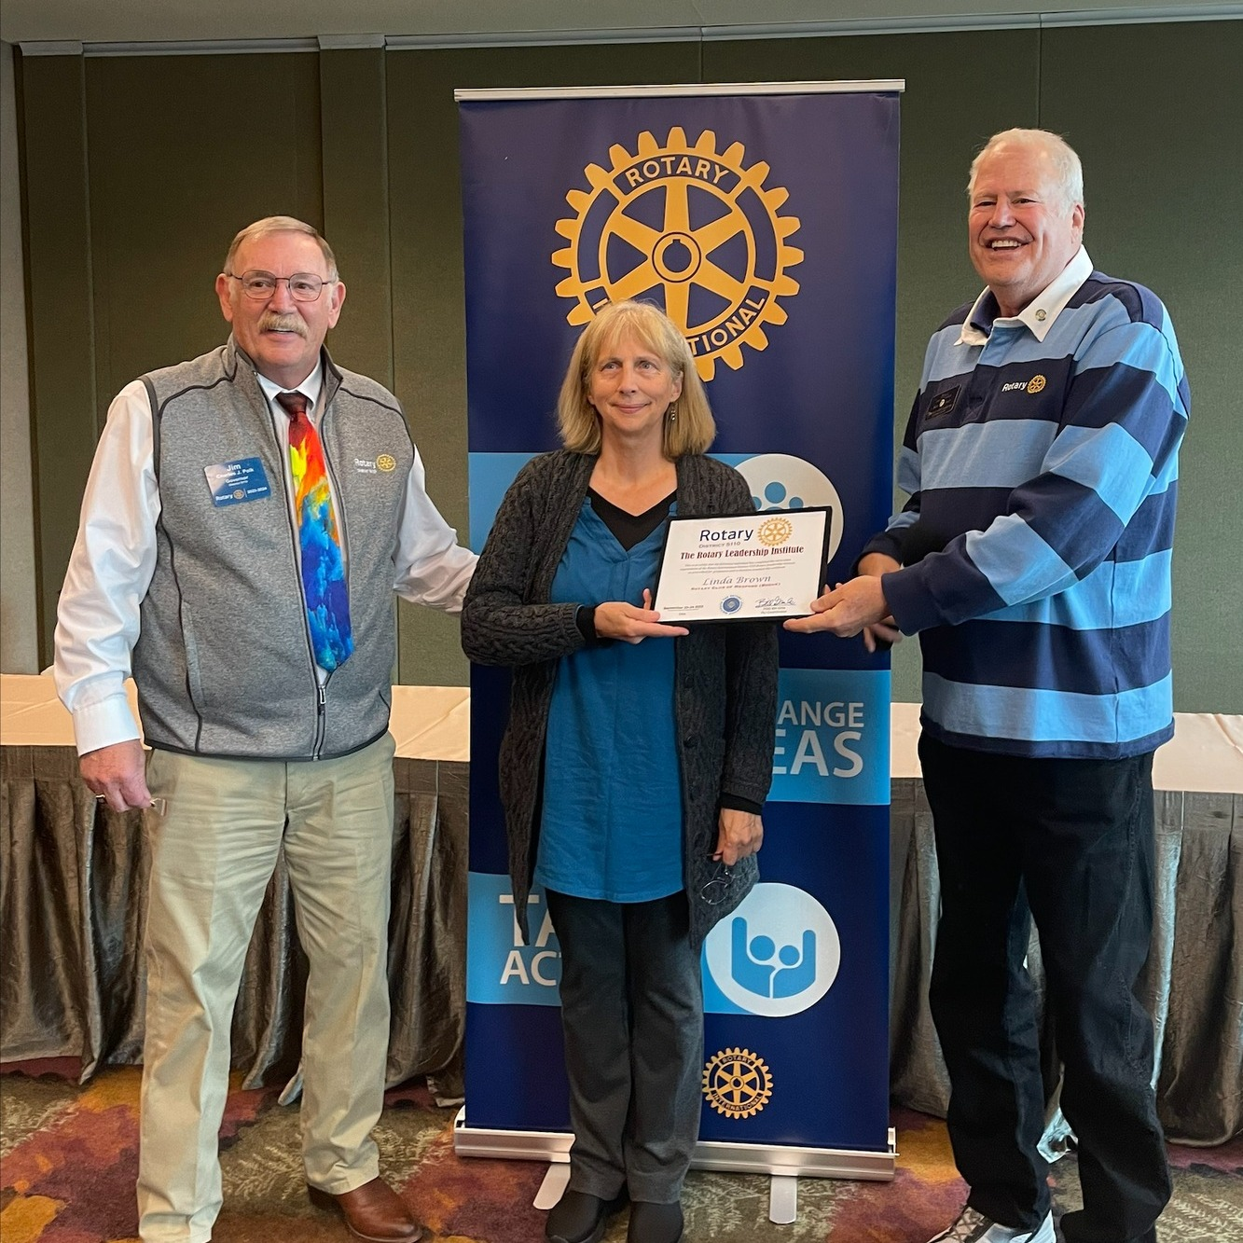
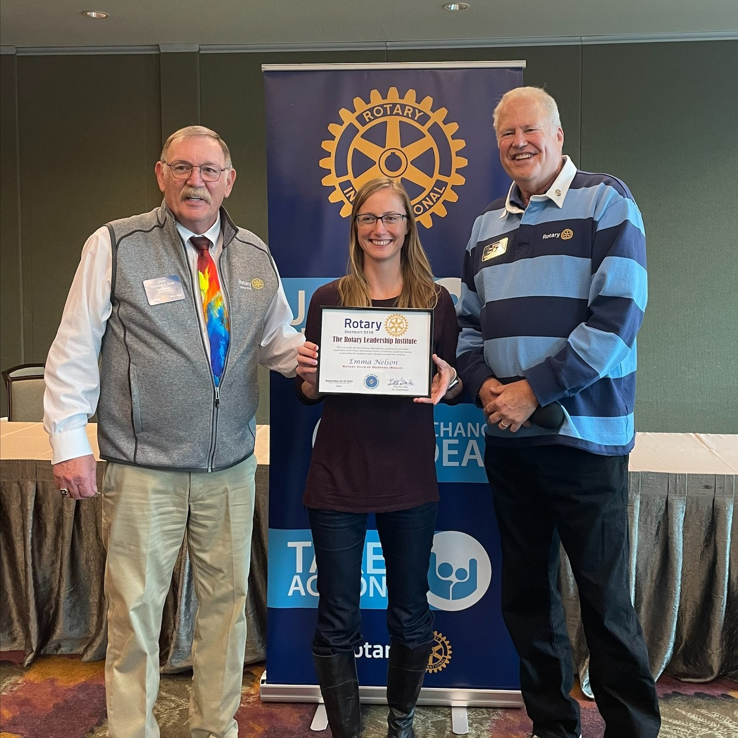
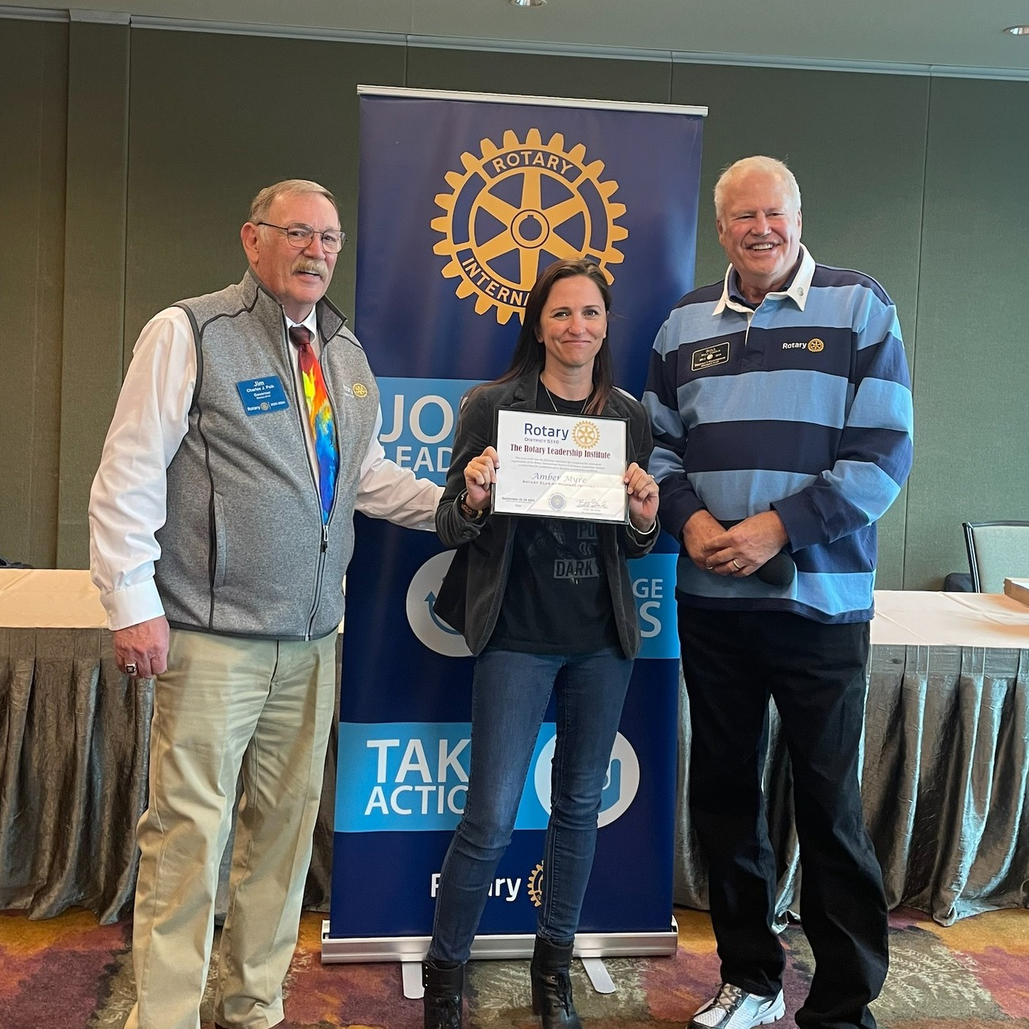
Member
Leadership
5 Members Attended the District Conference
6 Members Attended the District Training
3 Members Completed Rotary Leadership Institute
Linda Brown
Emma Nelson
Amber Myre

Slide 6
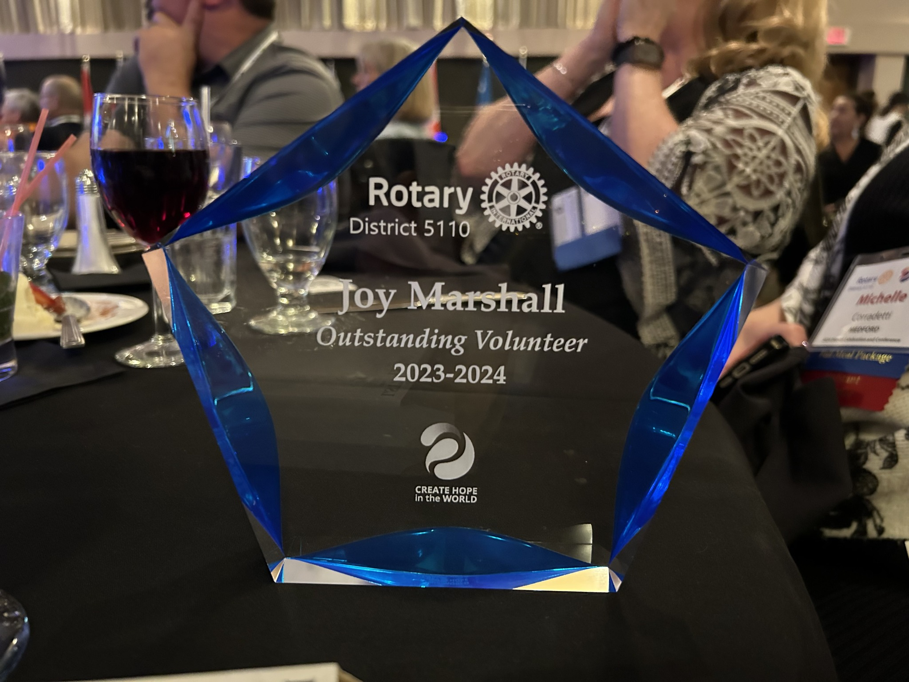
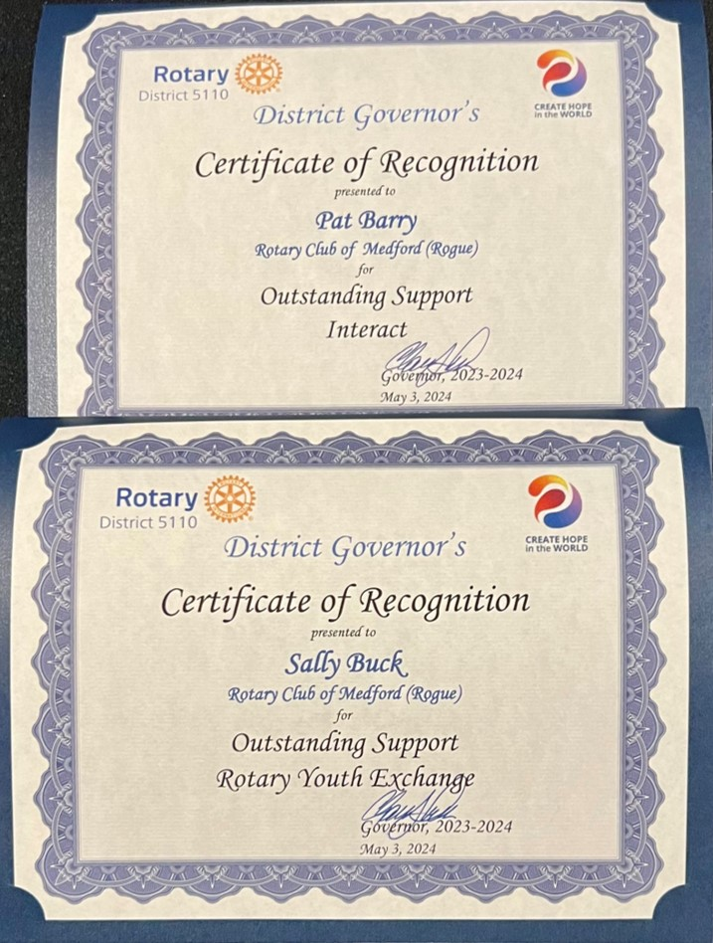
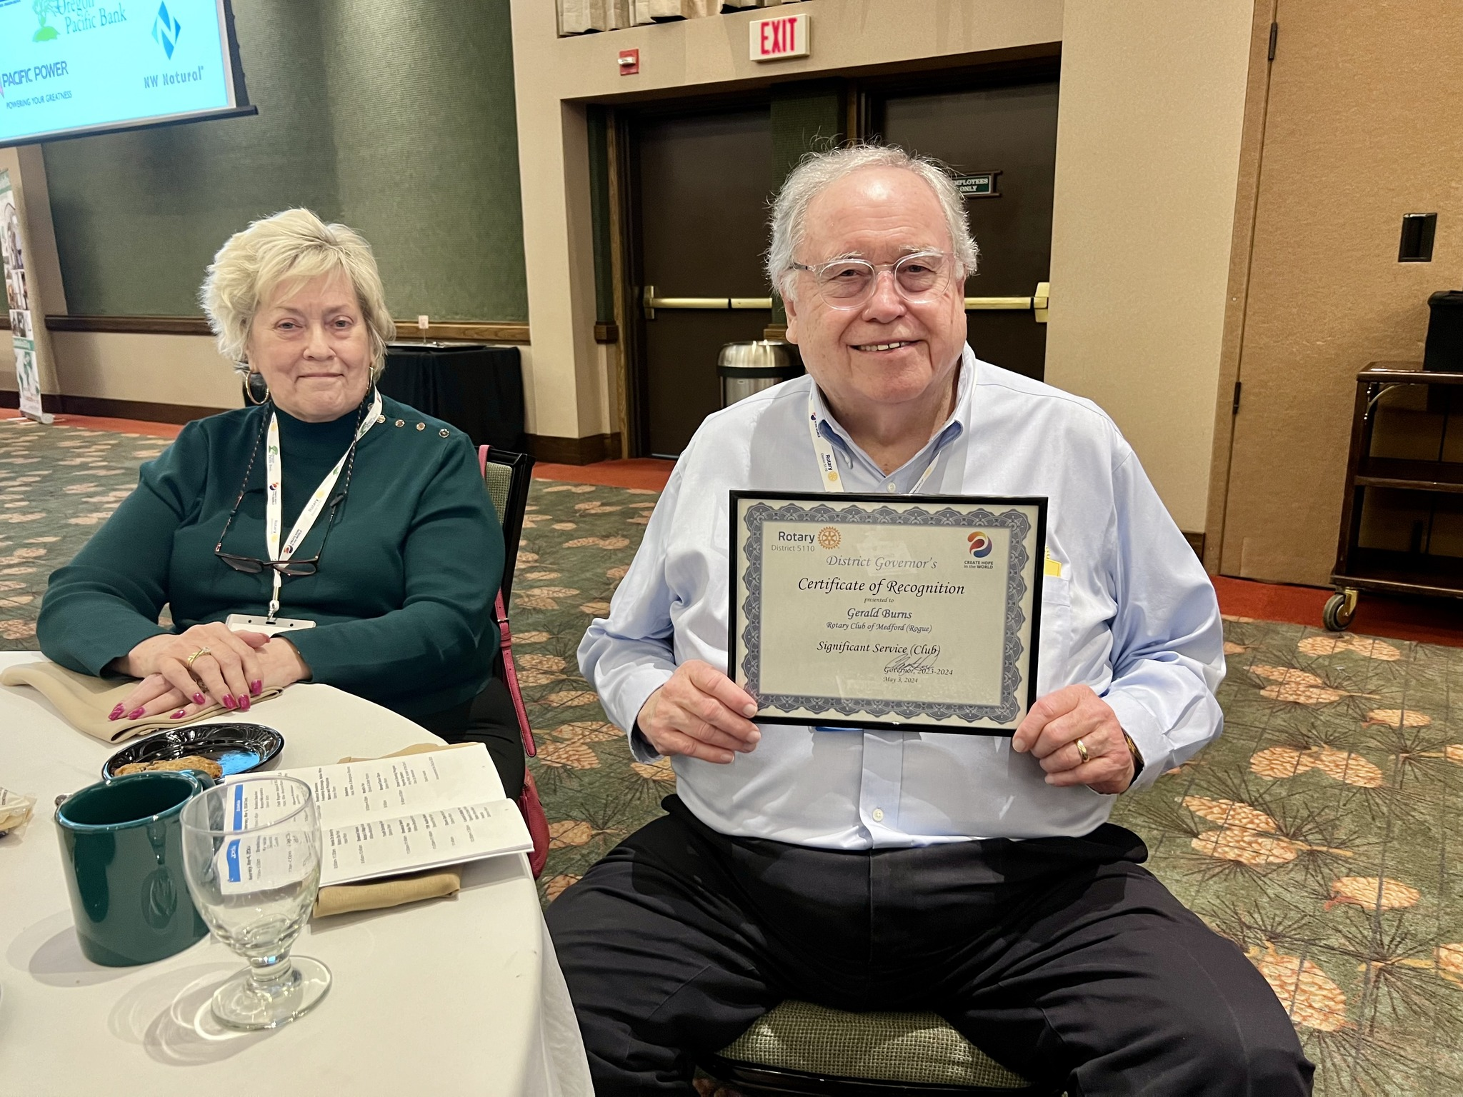
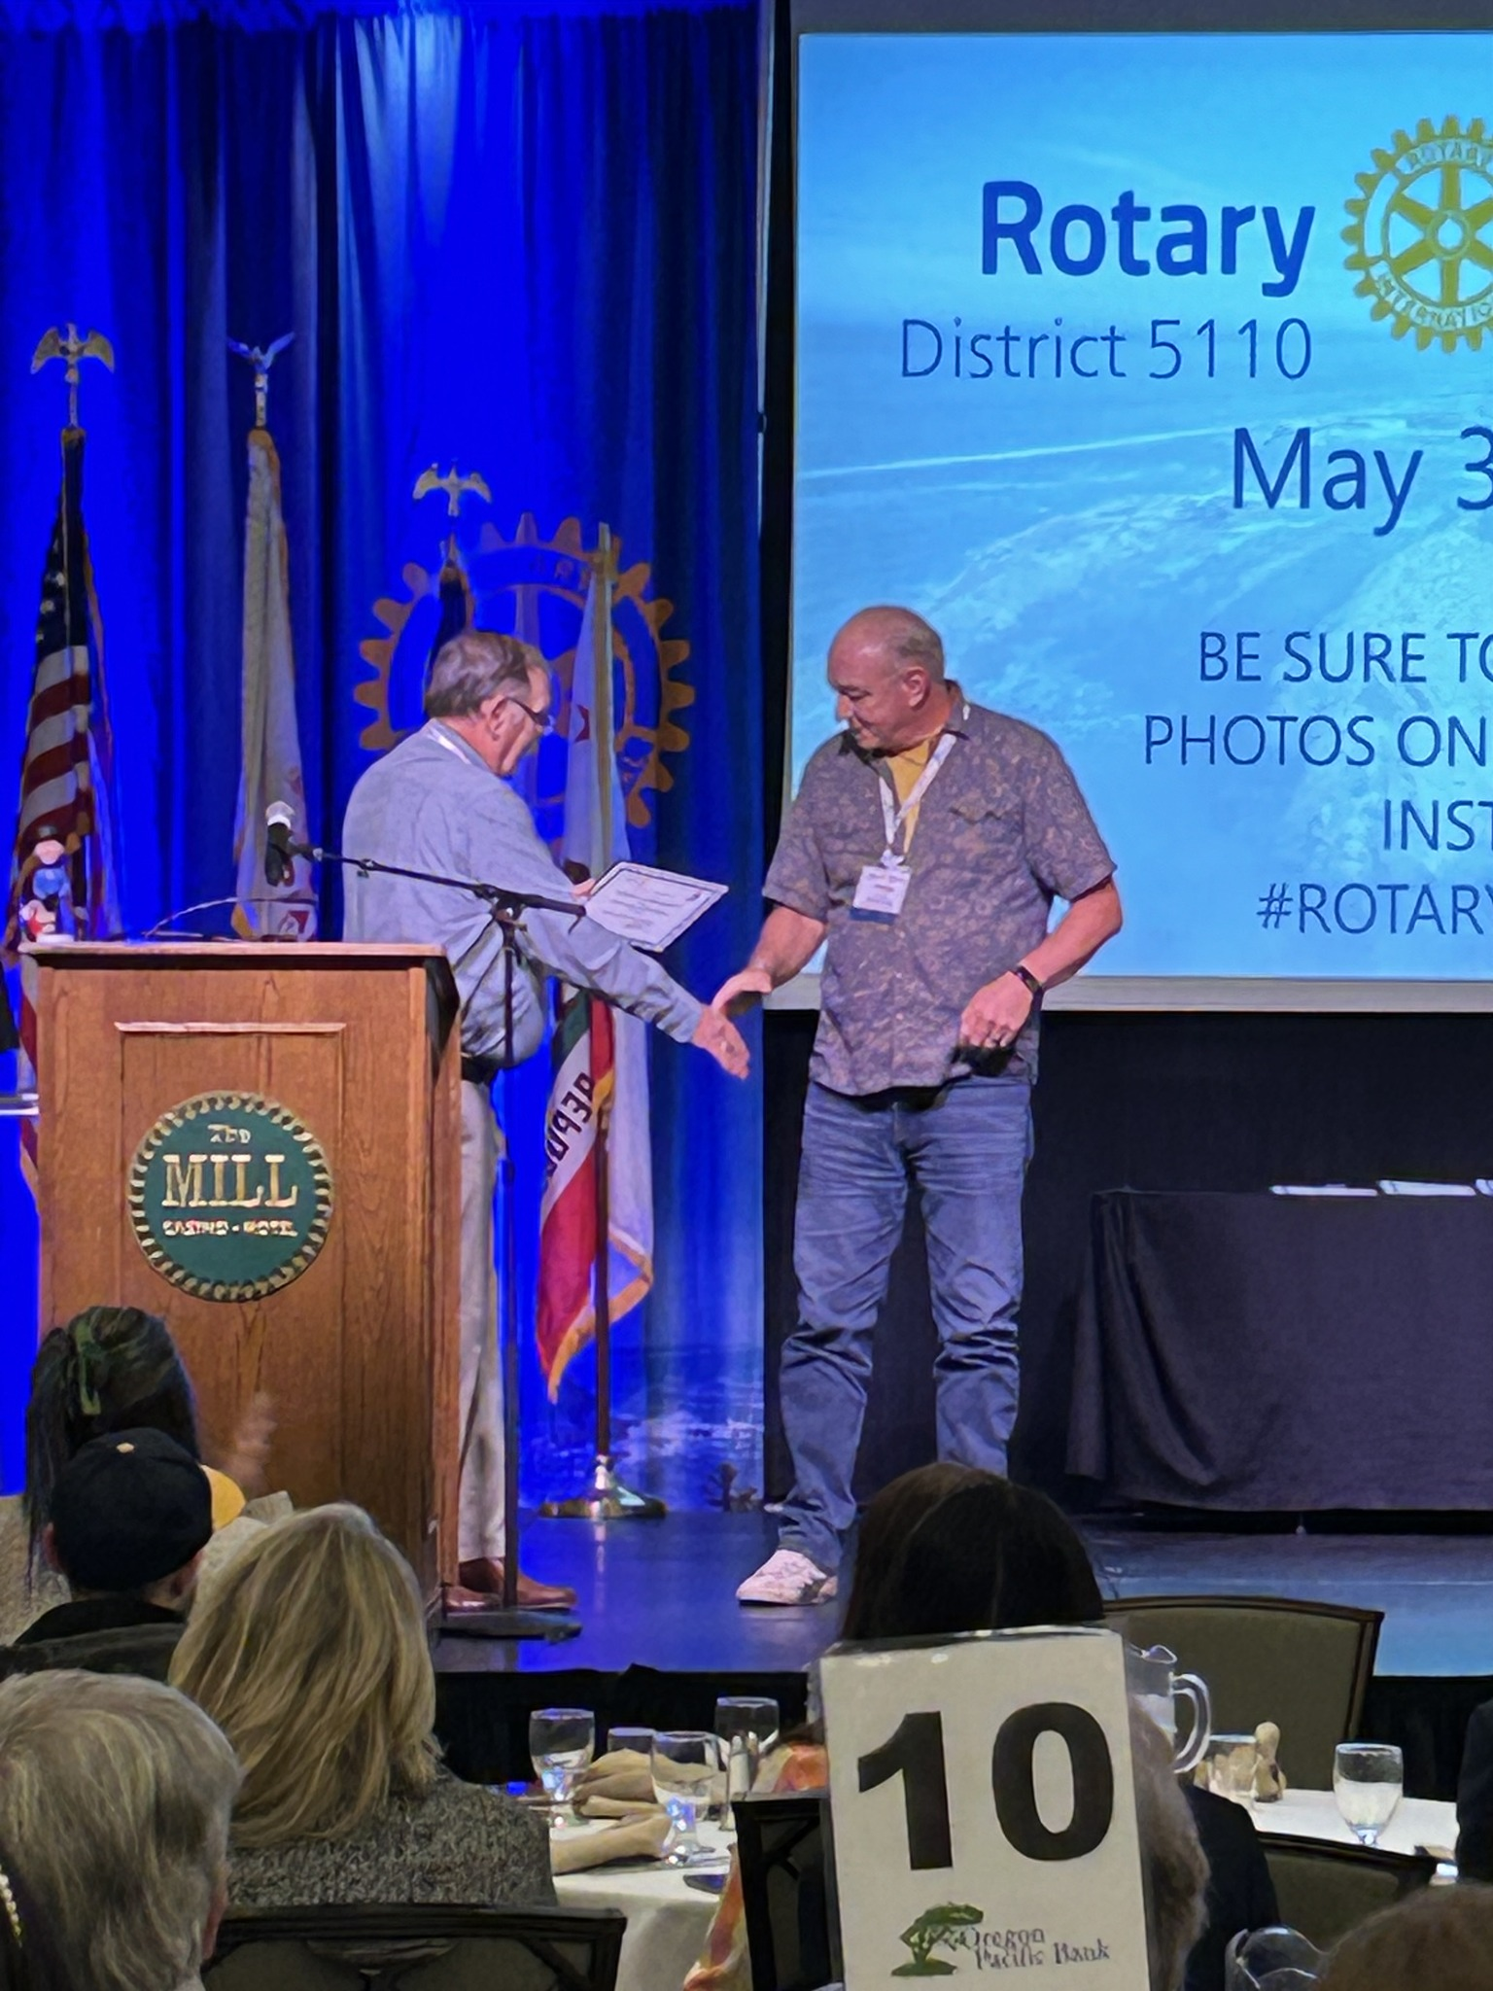
Member
Recognition
5 MRR Members recognized by the District:
Pat Barry
Sally Buck
Gerry Burns
Joy Marshall
George Prokop
Notes:
For their outstanding service to the Club

Slide 7
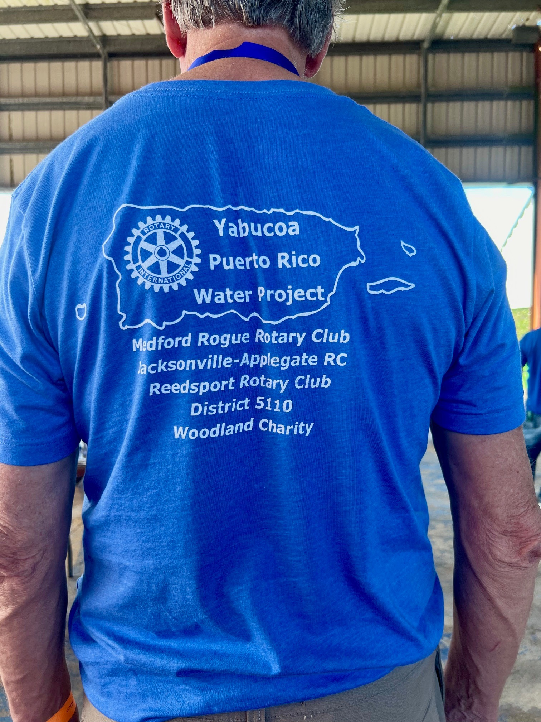
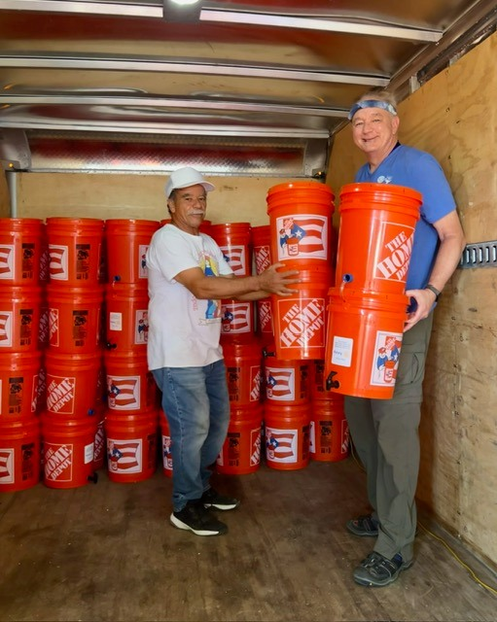
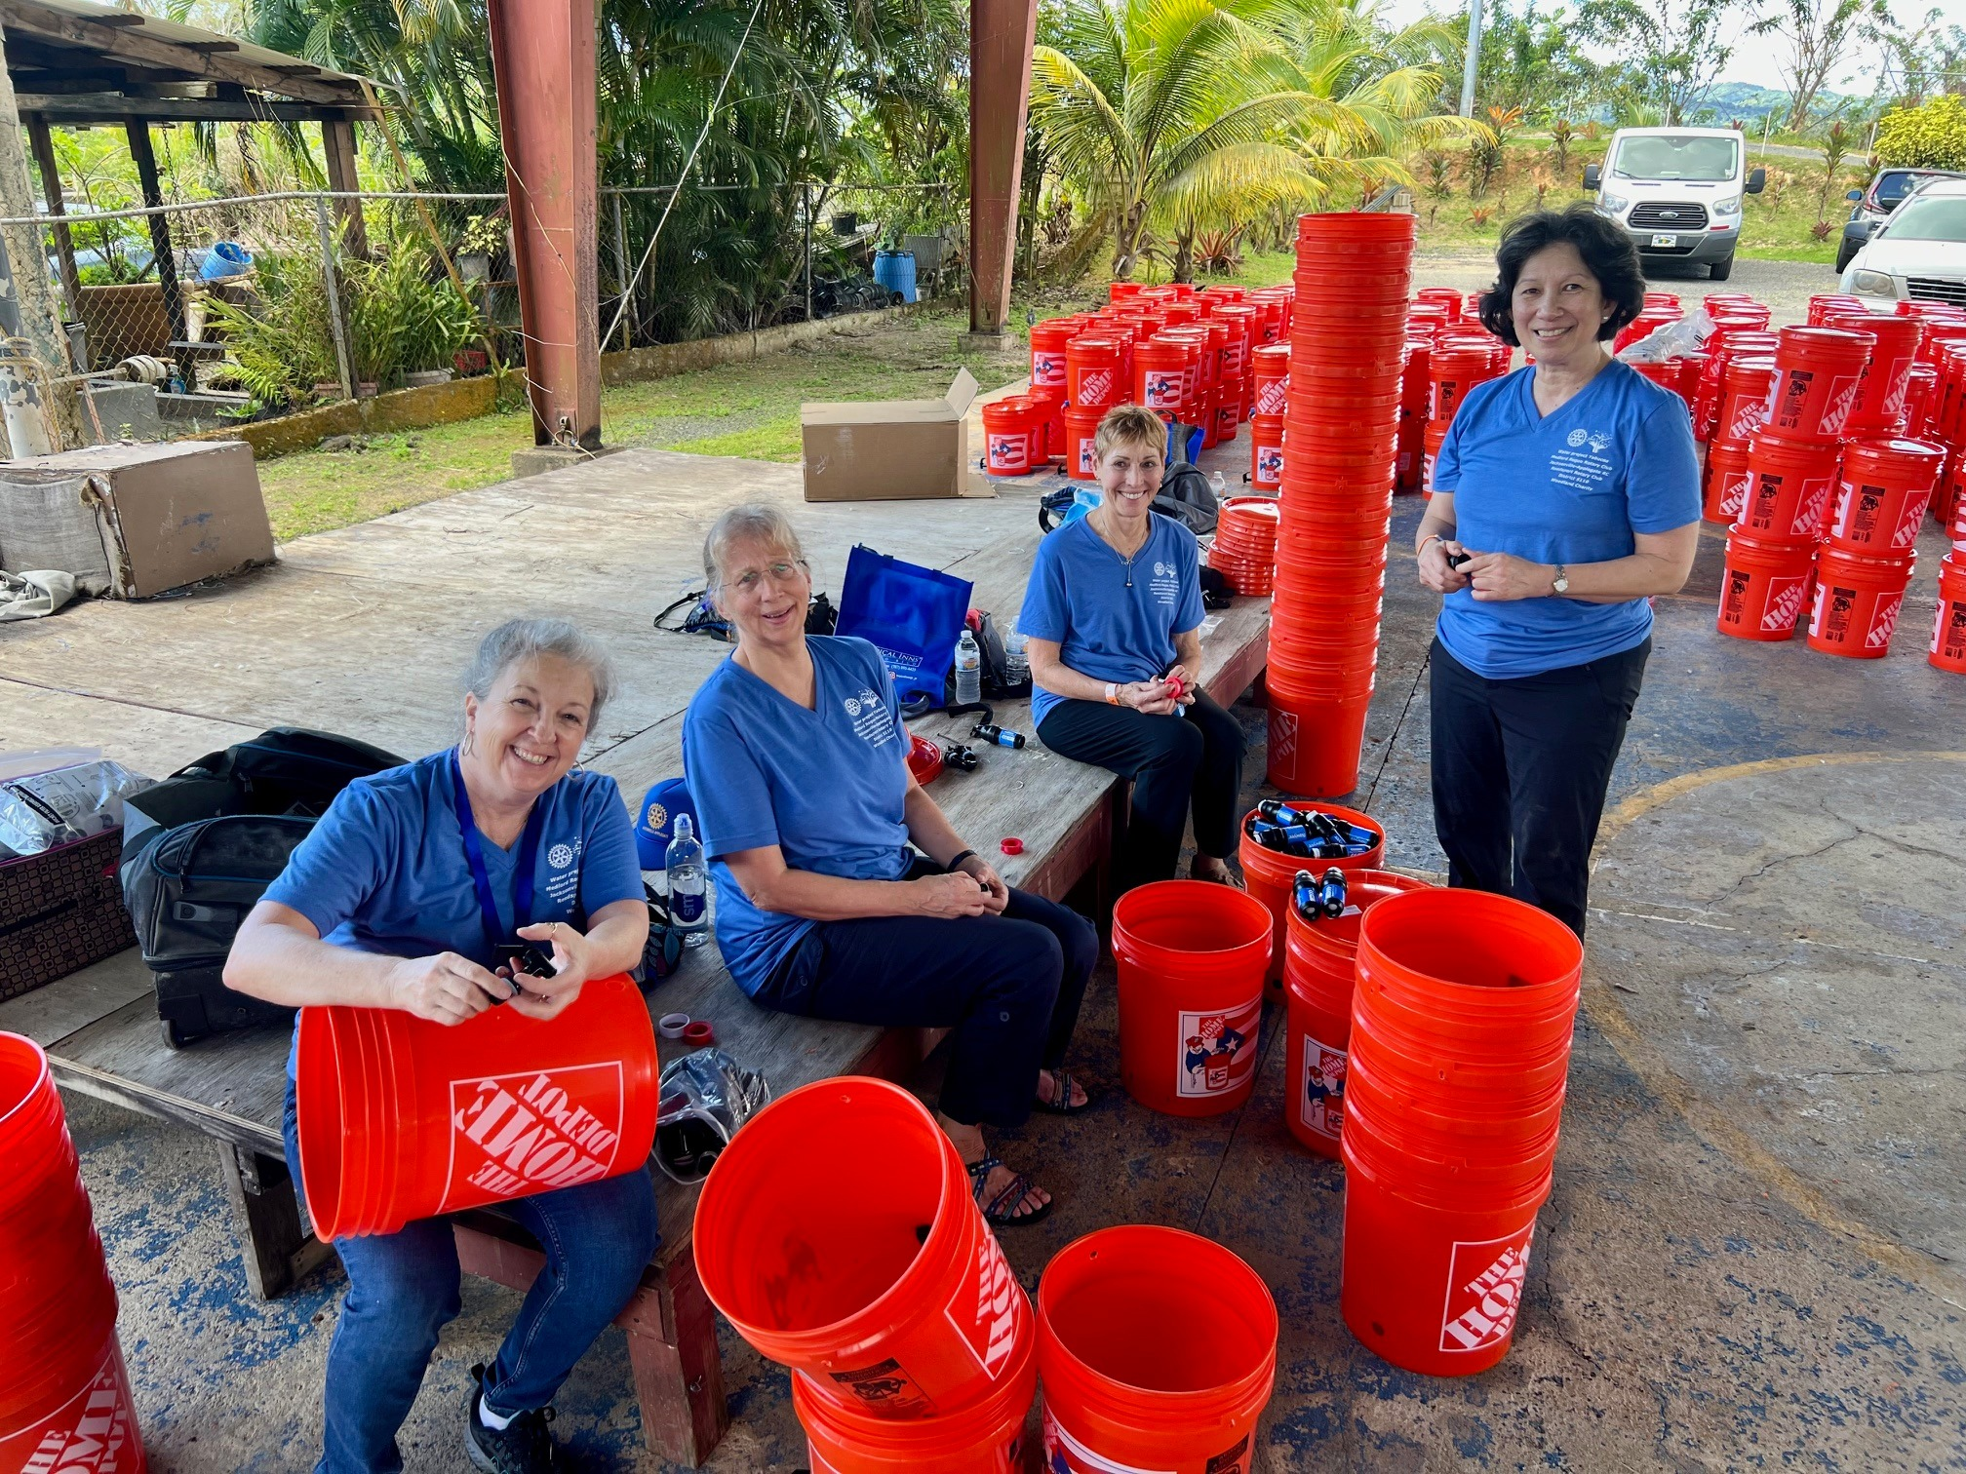
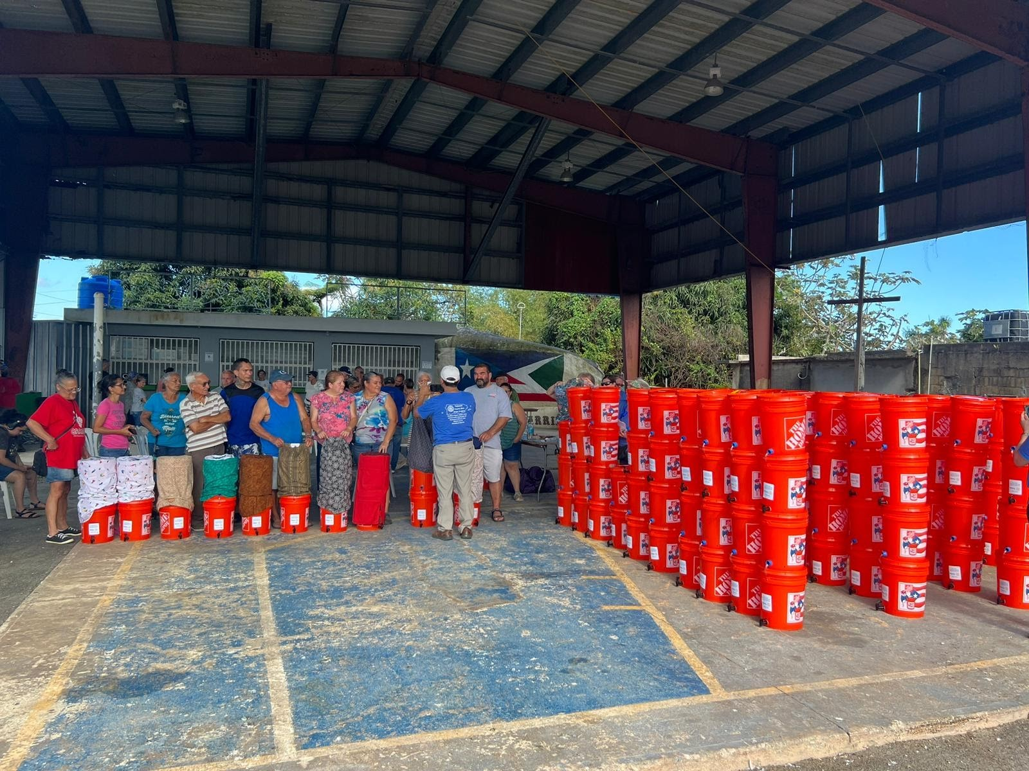
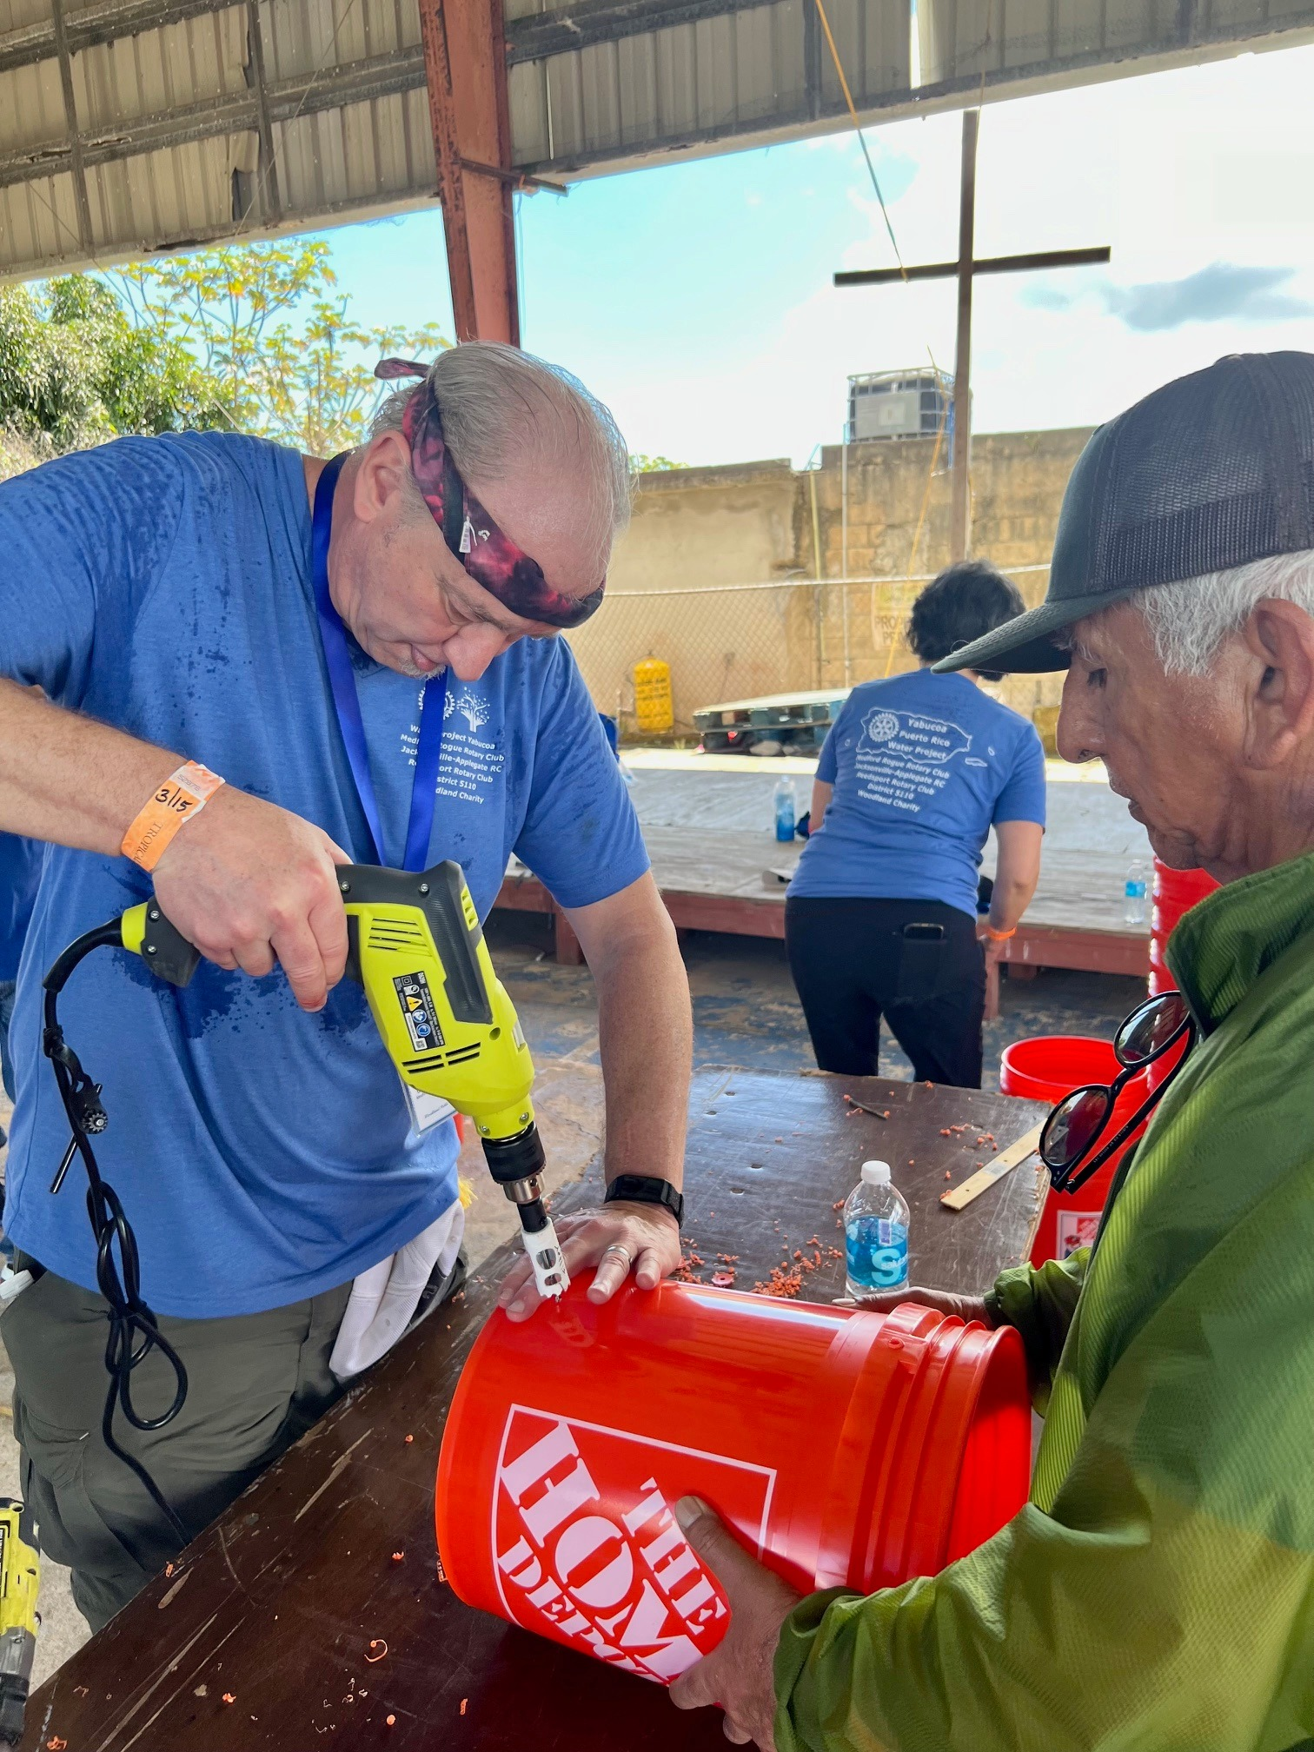
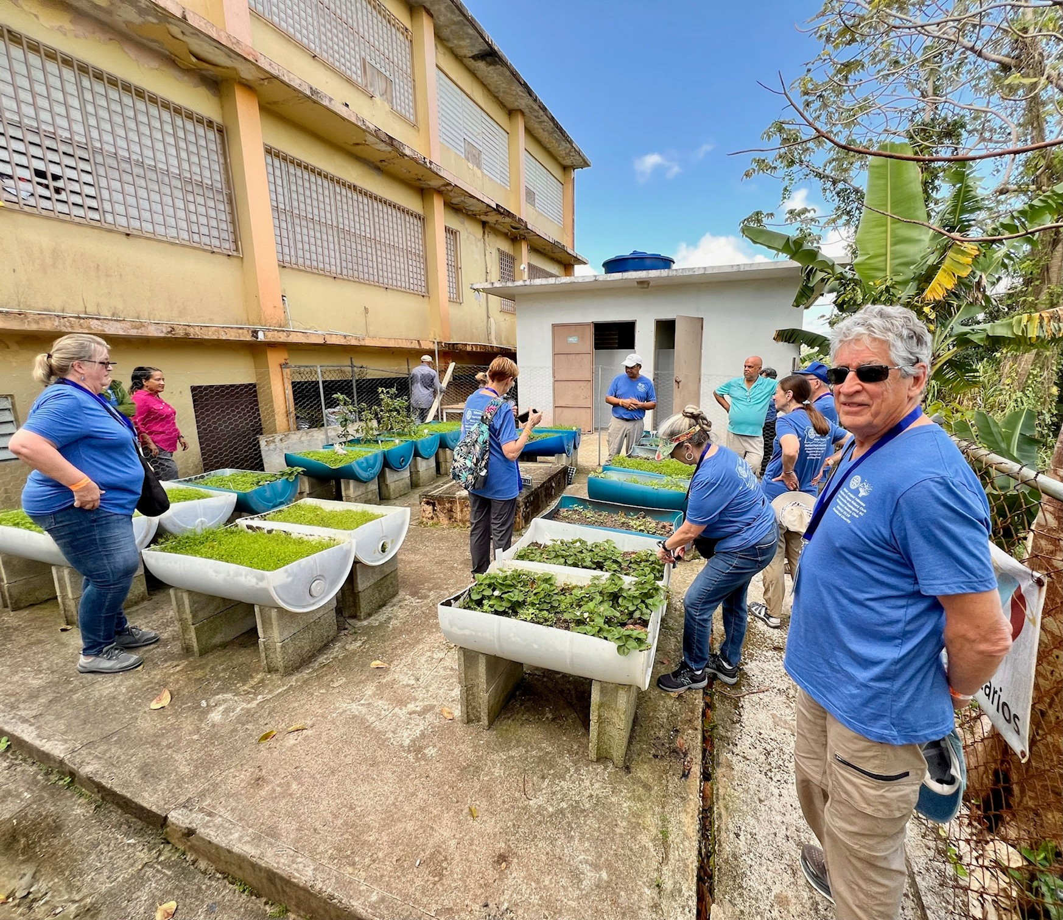
World
Community
Service
300 water systems built in Puerto Rico plus provided a large TV screen, first aid kits, school supplies, gardening tools, computers, etc. = $19,450
Guatemala Education Program K-12 to ensure kids stay in school & Nutritional Support to 65 Guatemalan families = $7,000
Nutritional Forest Program in Ecuador = $1000
Water and Sanitation project in Ghana = $315
Teacher literacy training in Botswana = $500
July 10th meeting will be the highlights of
the Puerto Rico service

Slide 8
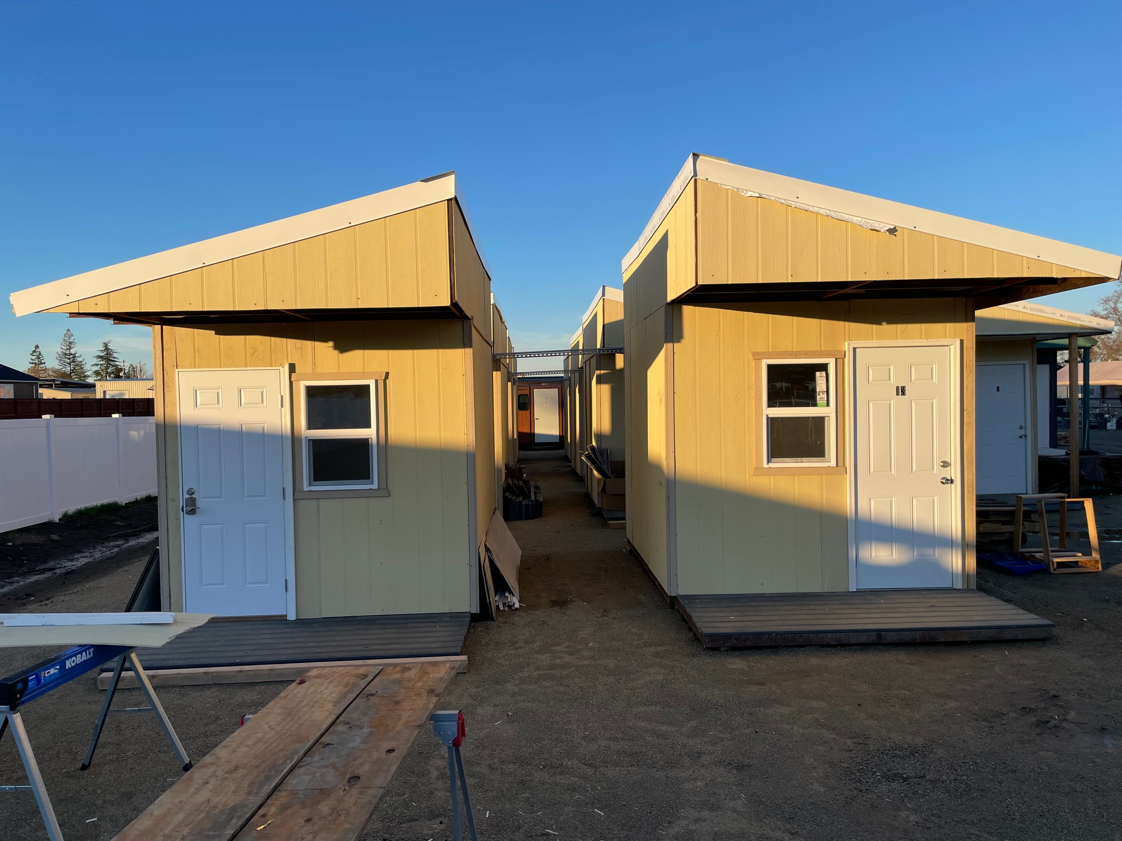
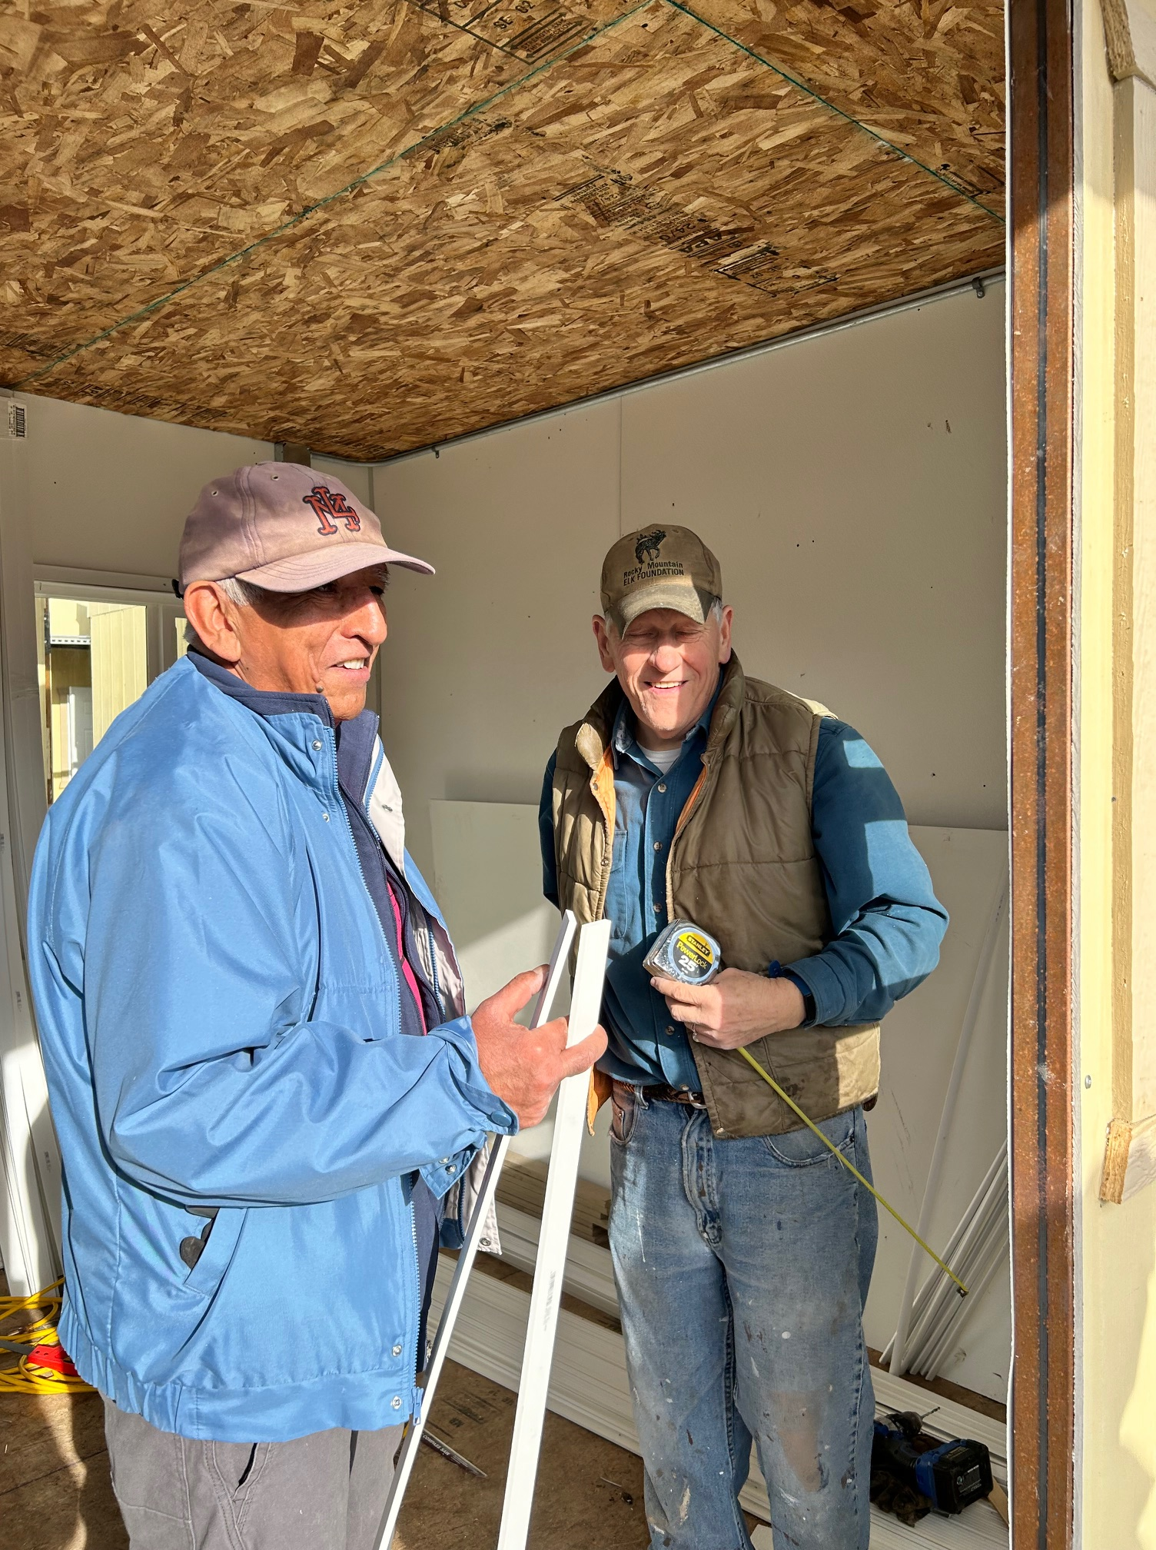
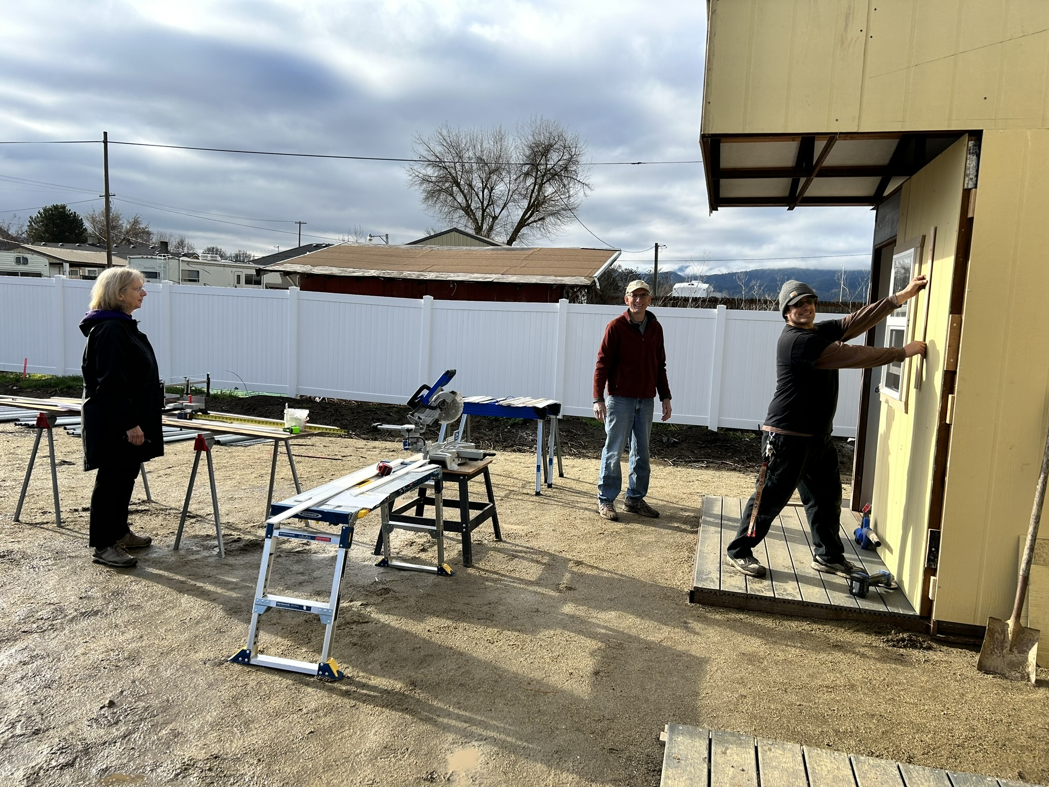
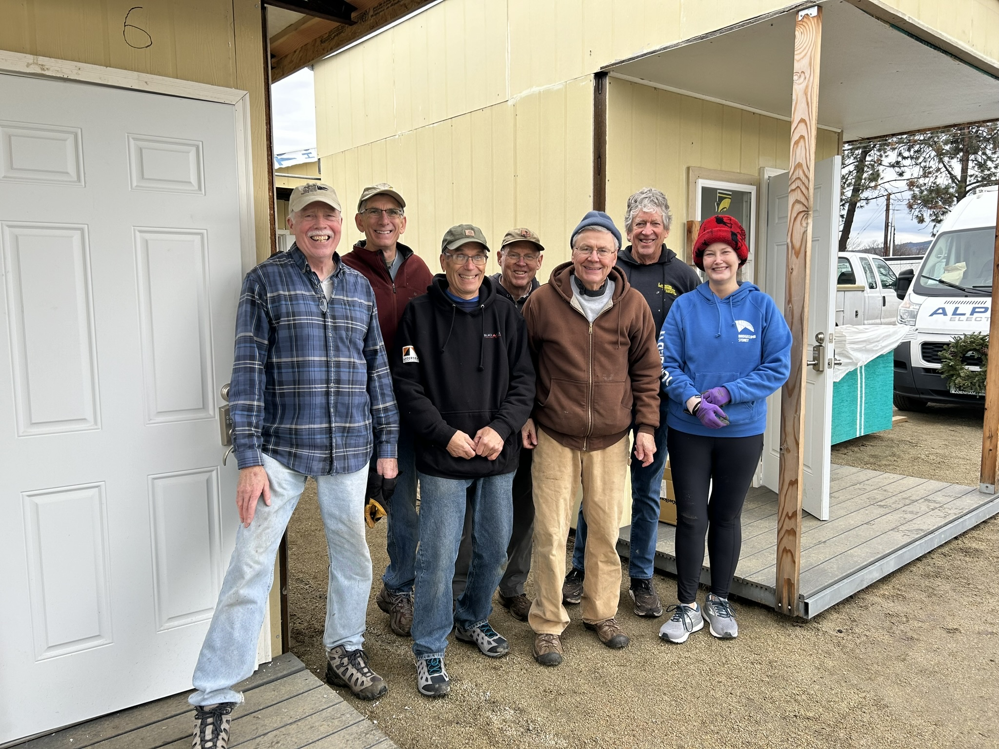
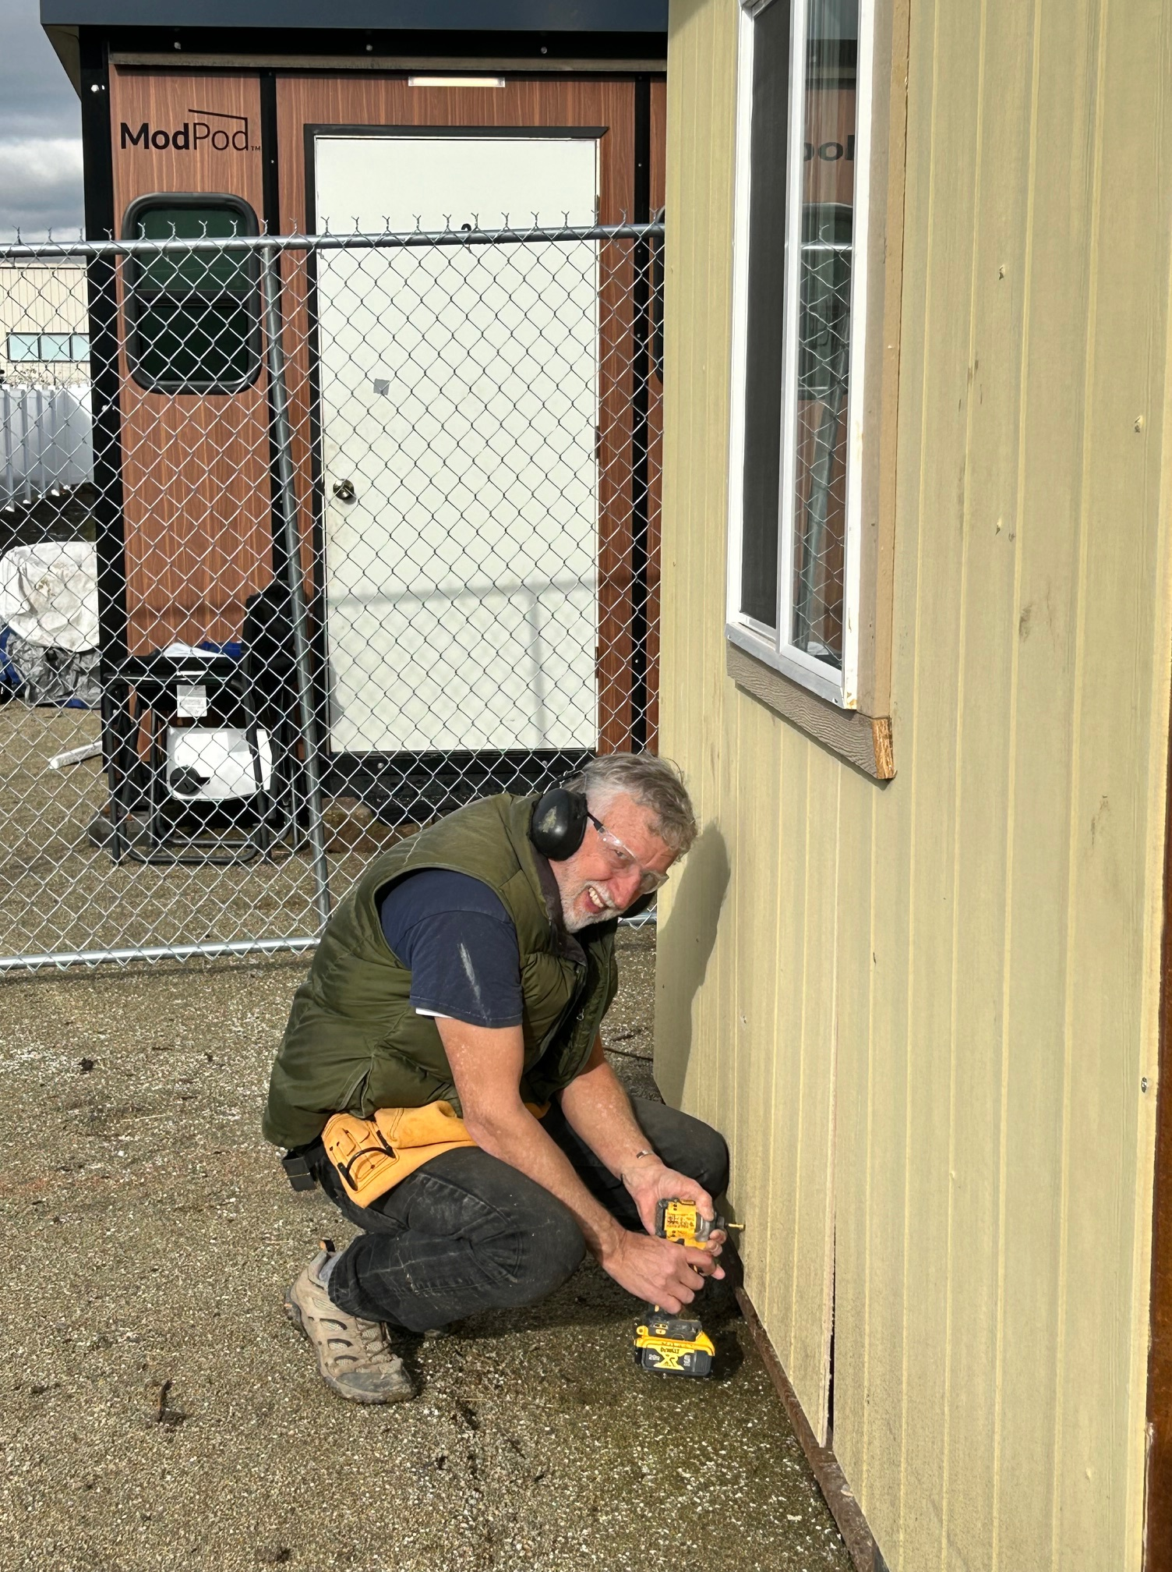
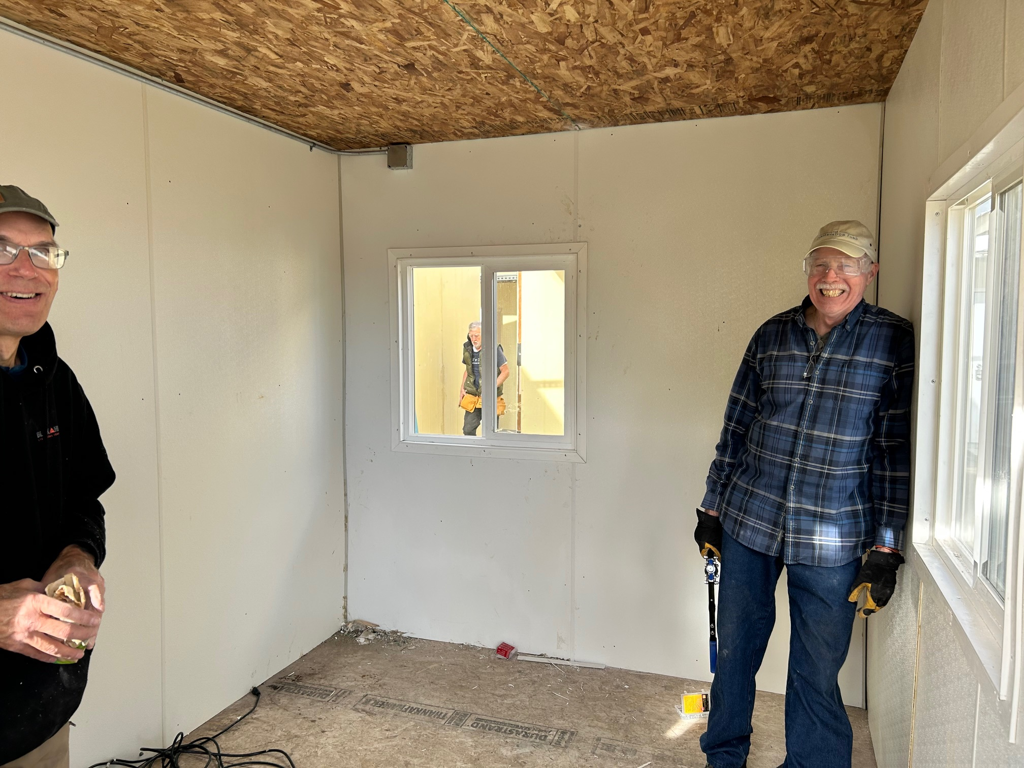
Tiny Houses
12 tiny houses completed for Rogue Retreat’s The Crossing
$13,000 from Club members

Slide 9
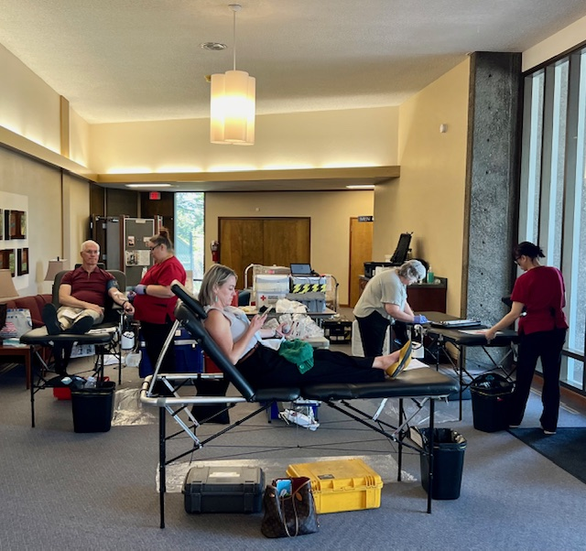
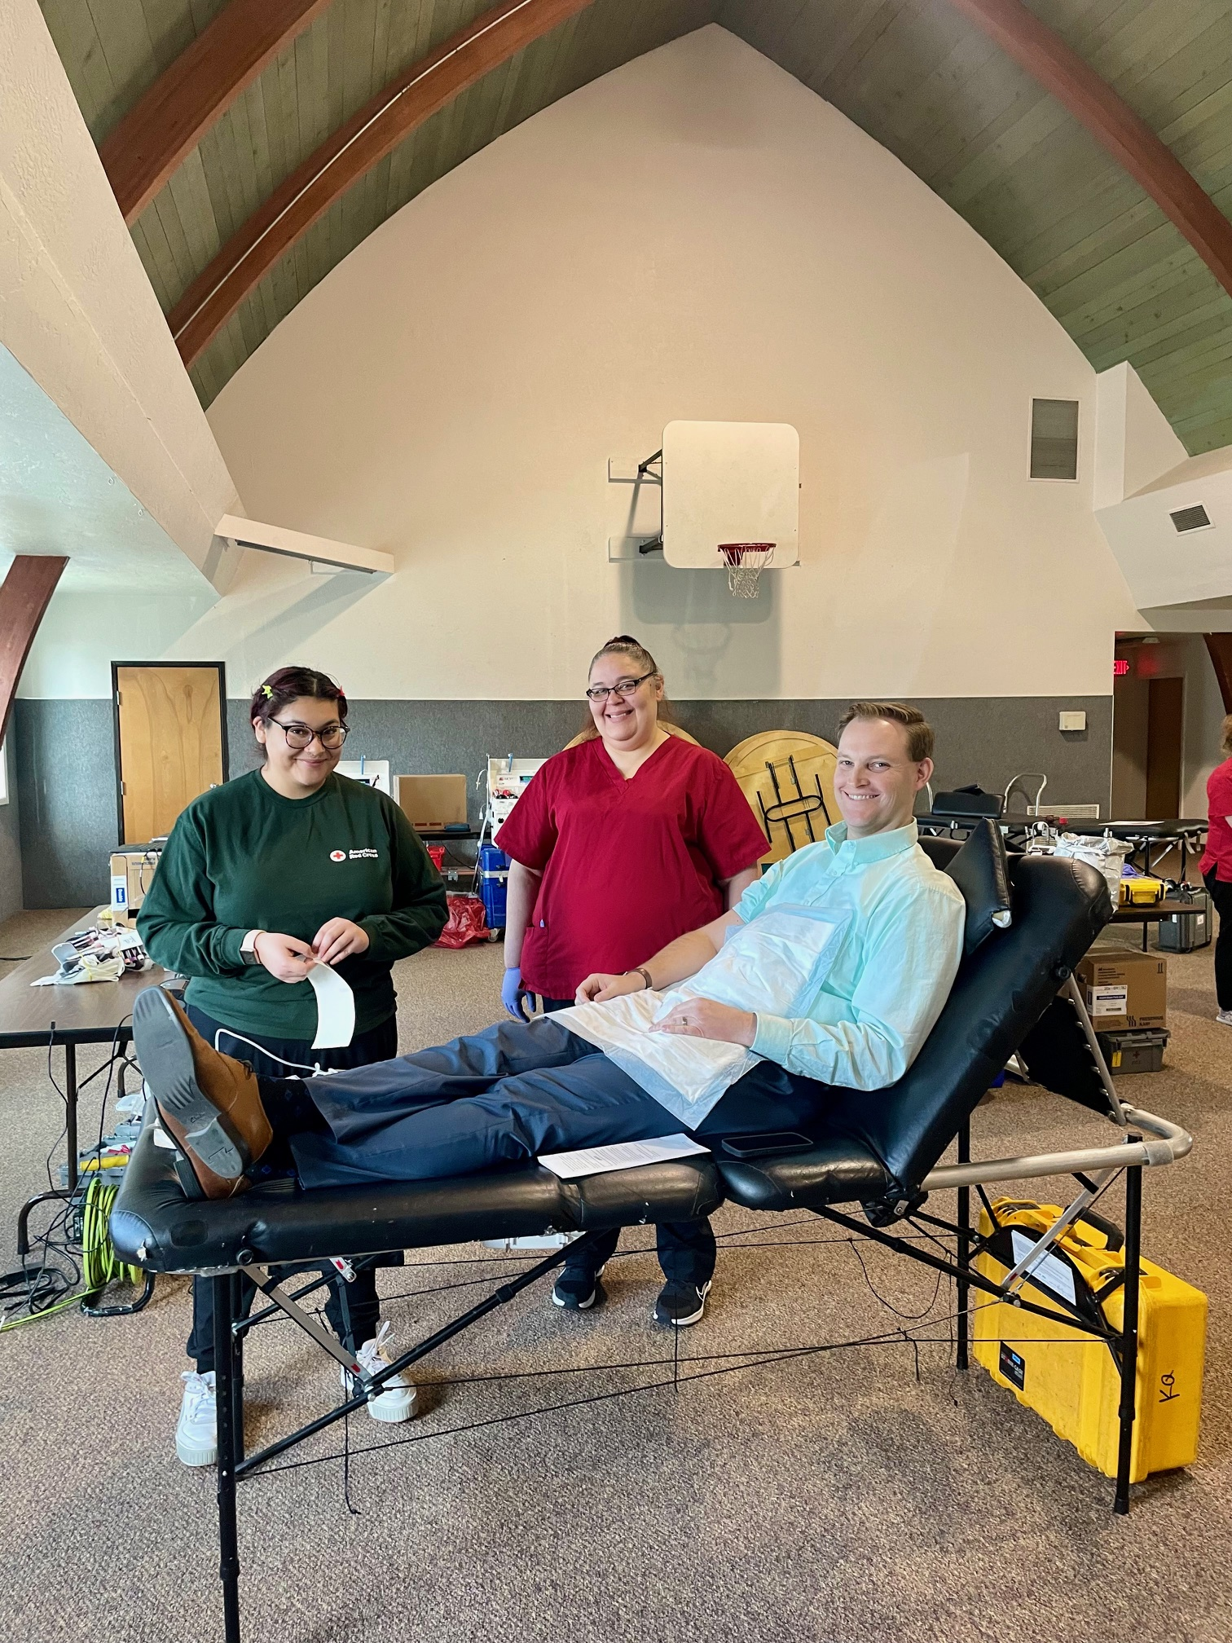
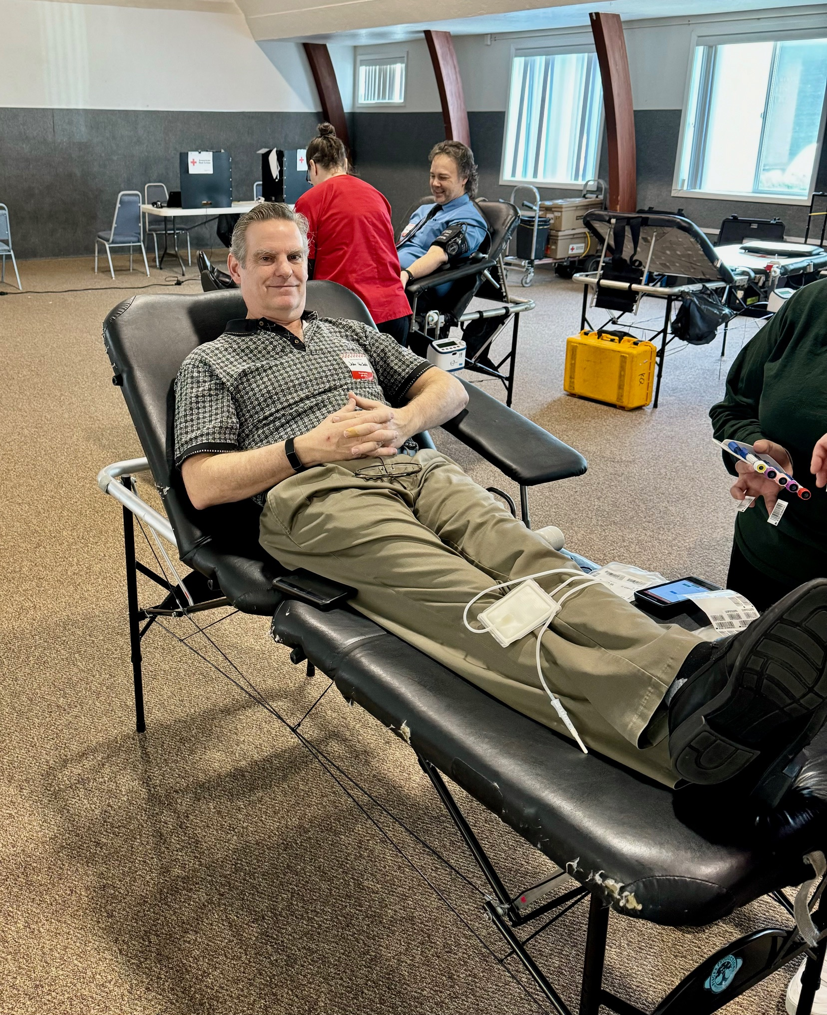
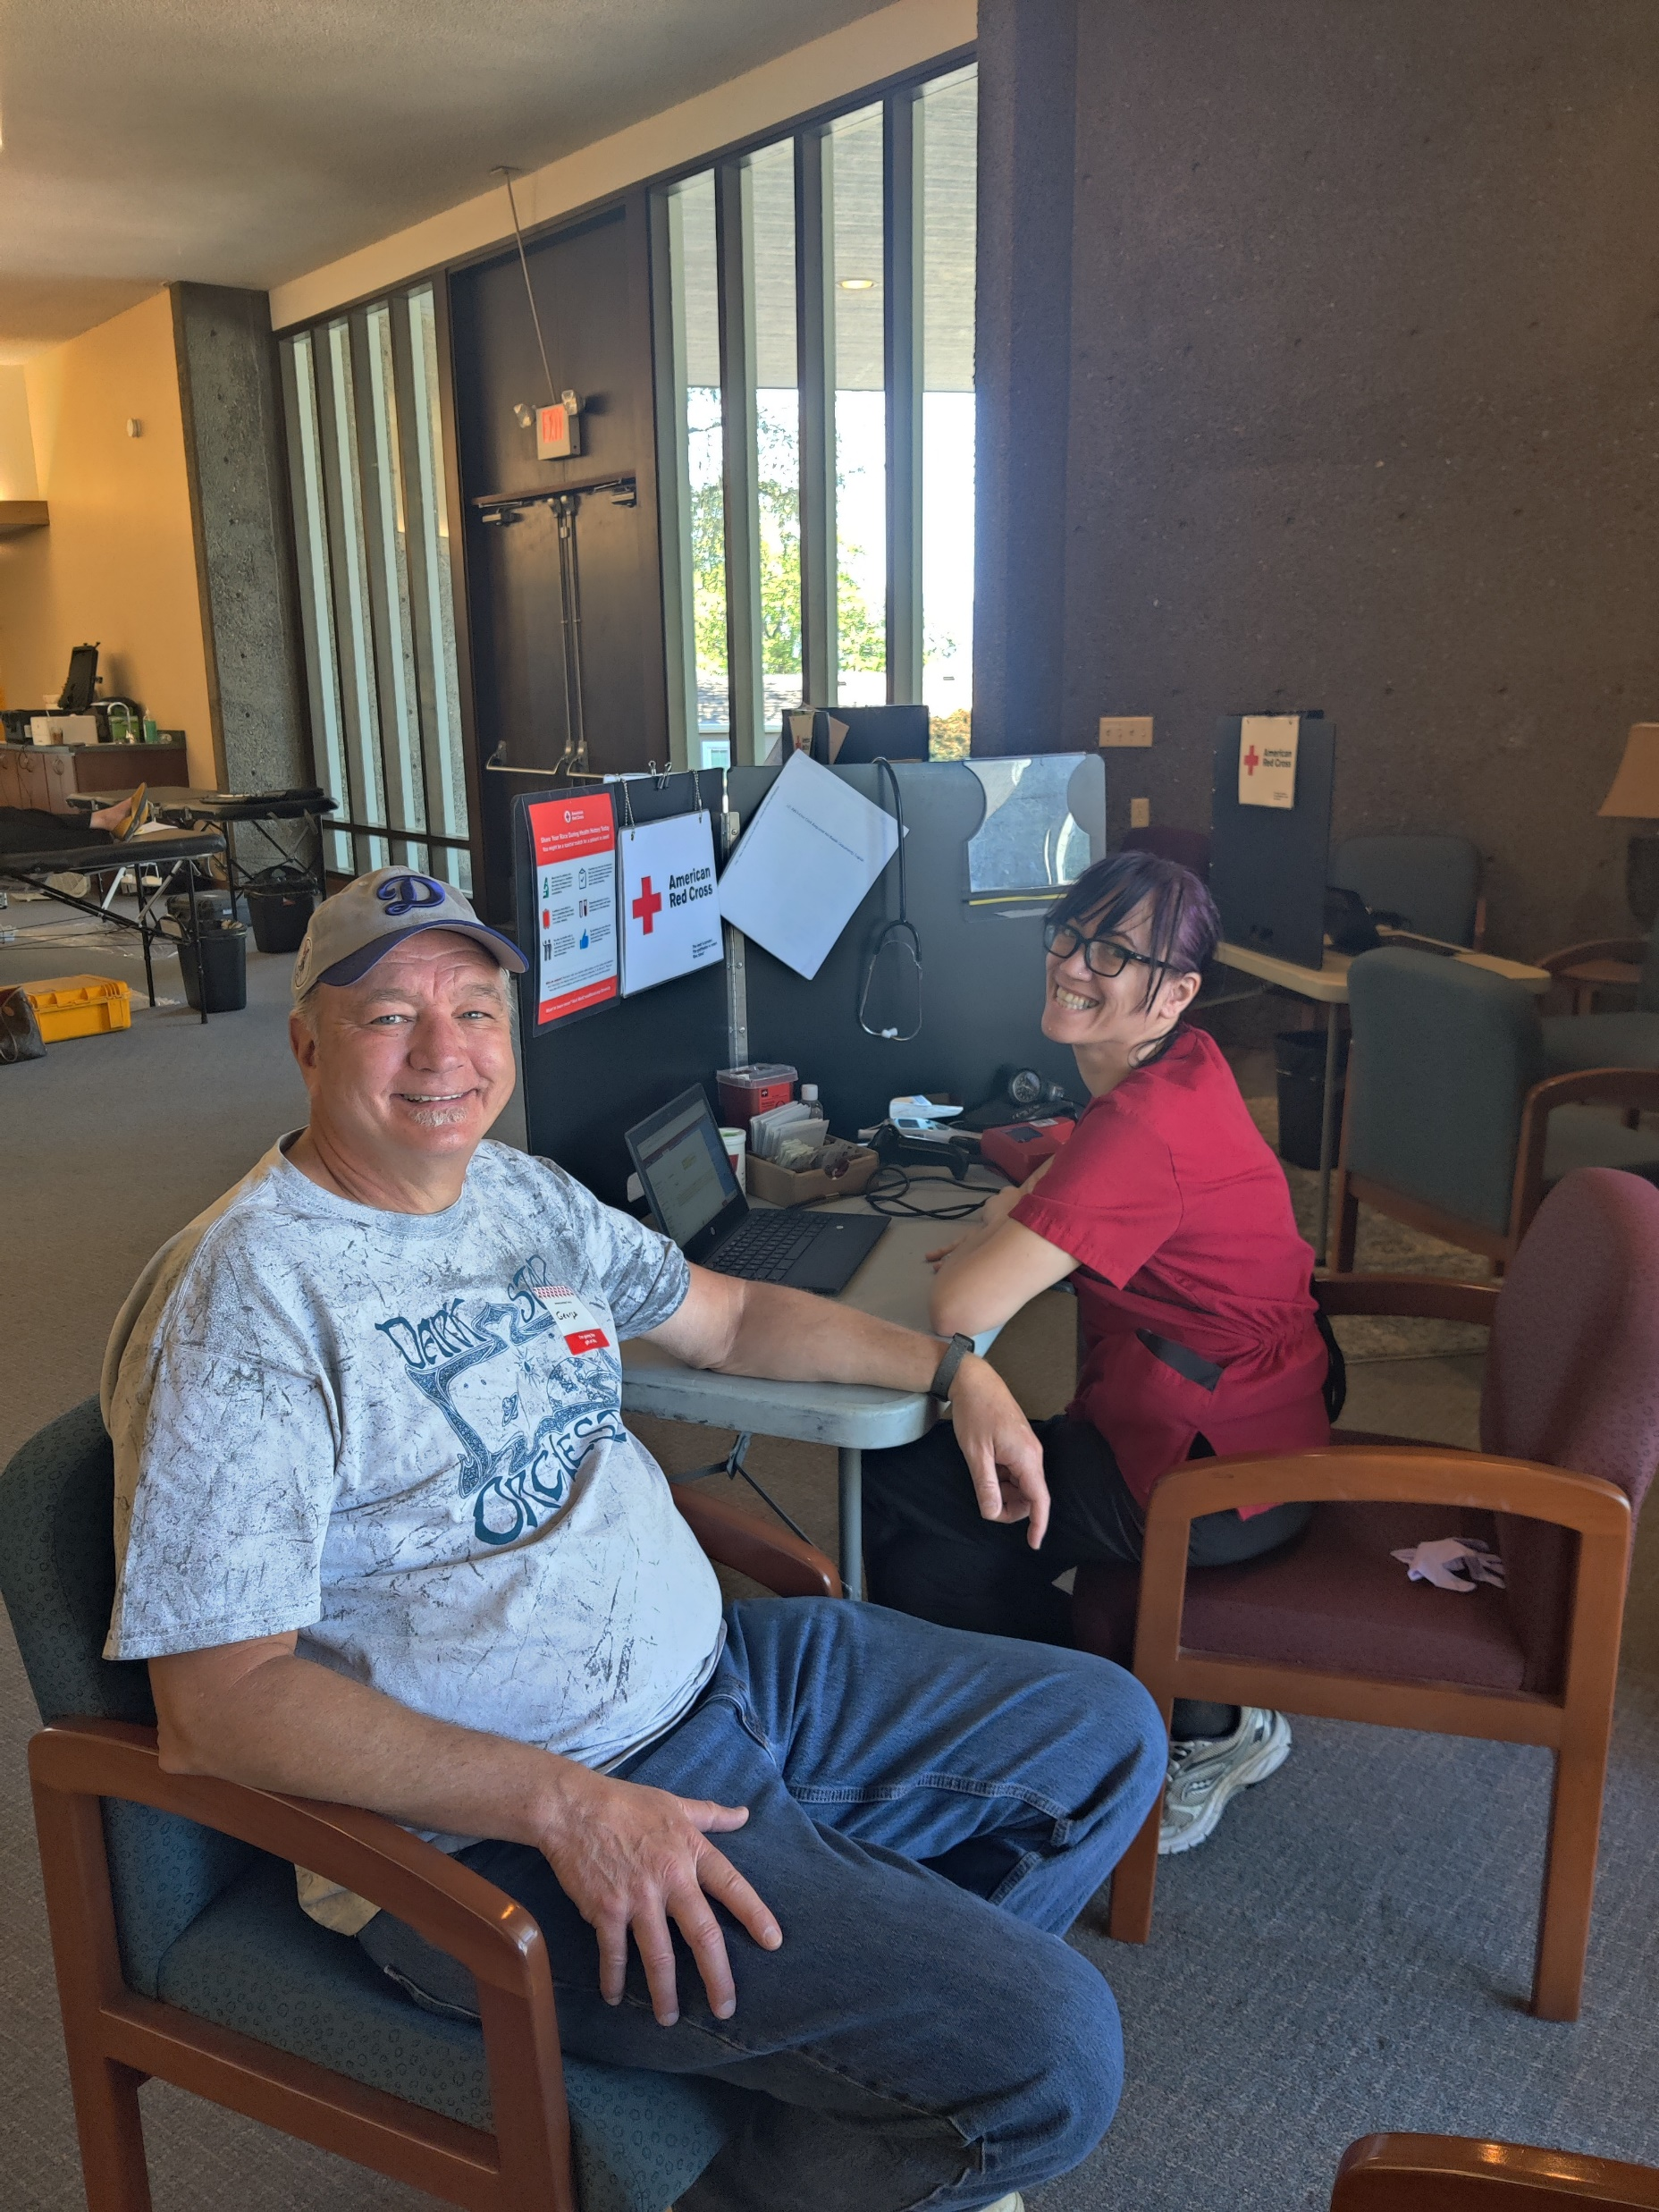
Blood Drives
5 drives
111 donations
120 units
360 lives potentially impacted
Notes:
Initiated

Slide 10
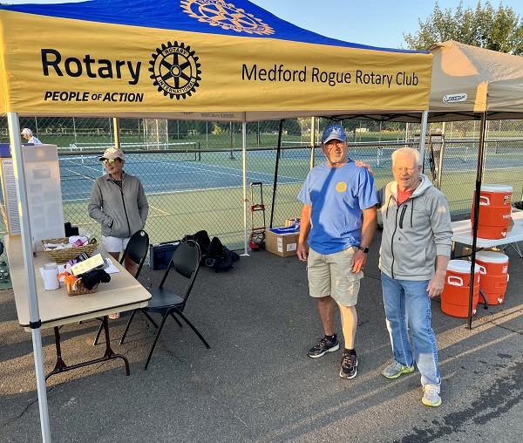
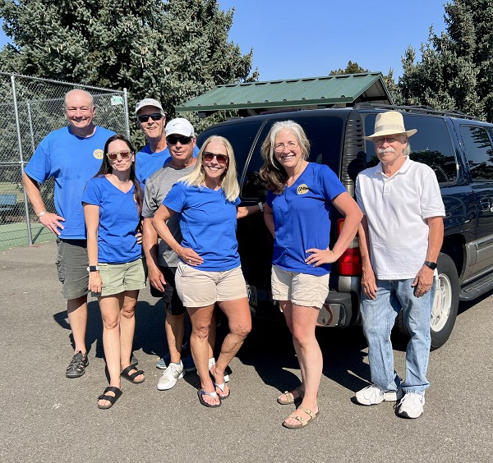
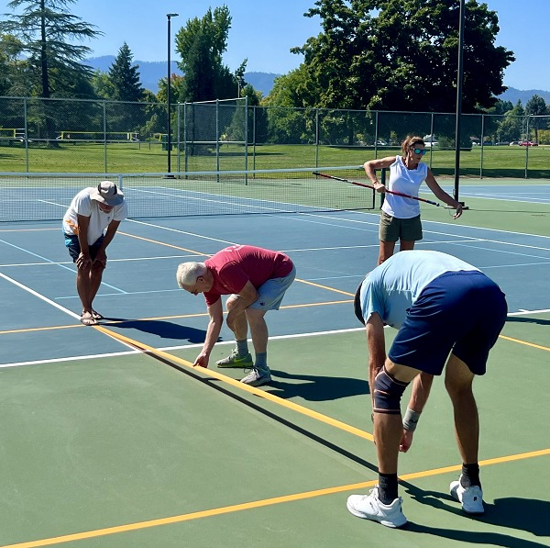
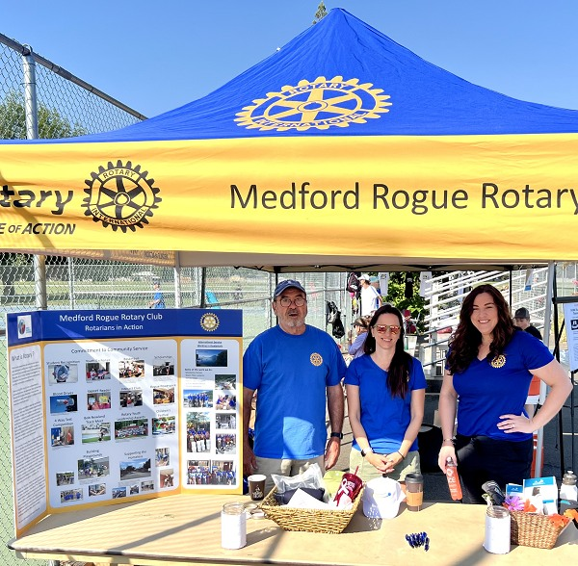
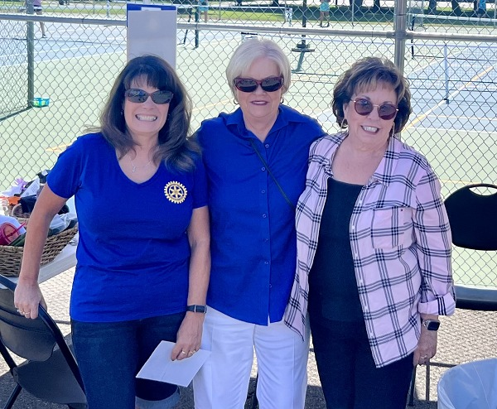
Pickleball Fest
200 players in 3-day event
MRR Club Total Raised: $16,479.34
MRR Foundation Total Raised $8,350.00
All funds for youth activities this year
Notes:
So what did that money fund?

Slide 11
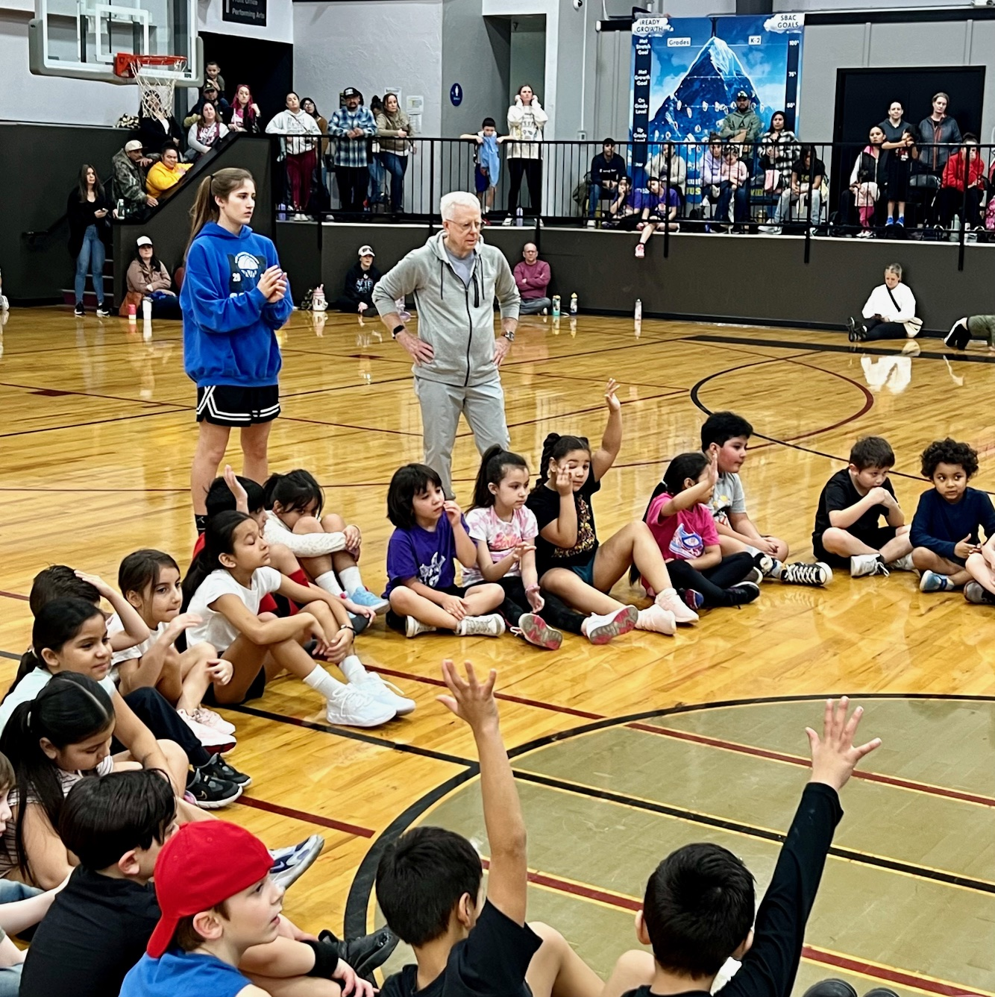
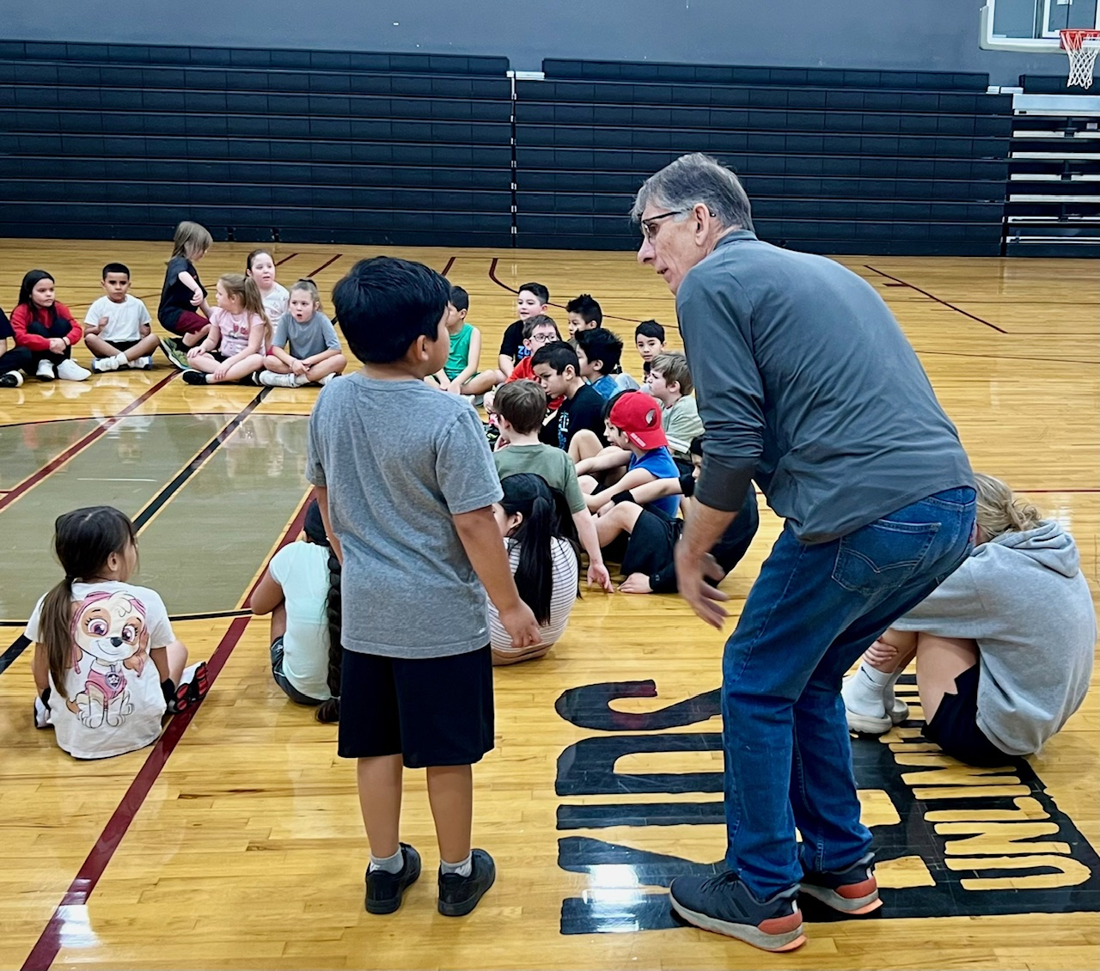
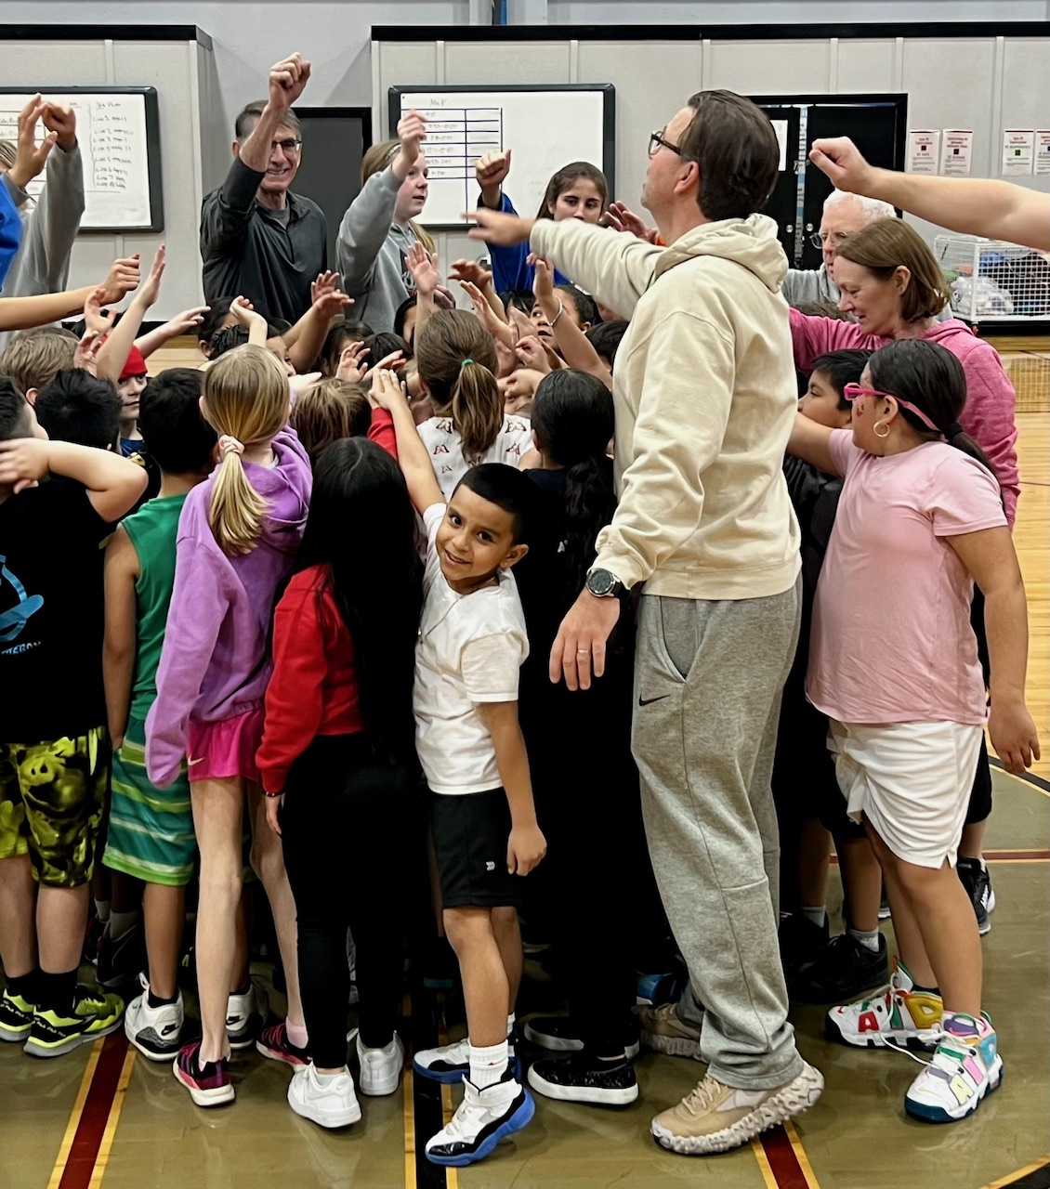
Kids Unlimited
Basketball
3 Saturdays with 2 hours of instructions to 120 students K-3rd grade
T-shirt to each student
Nutritional snacks
12 MRR Member Volunteers
Notes:
Return of – after hiatus

Slide 12
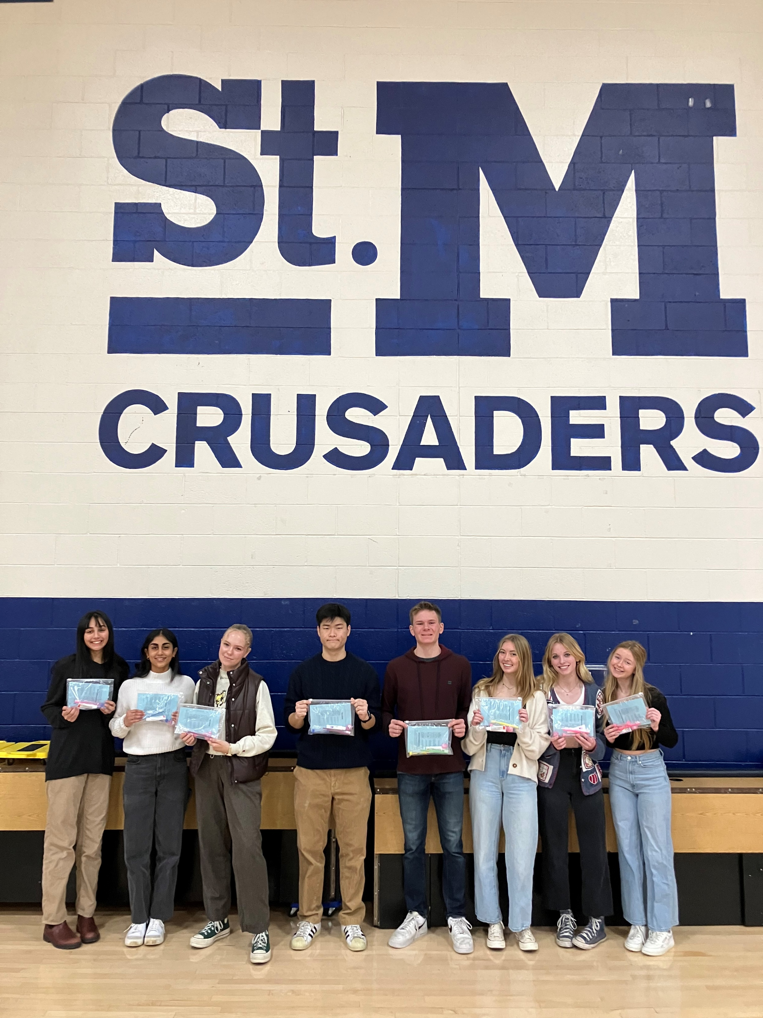
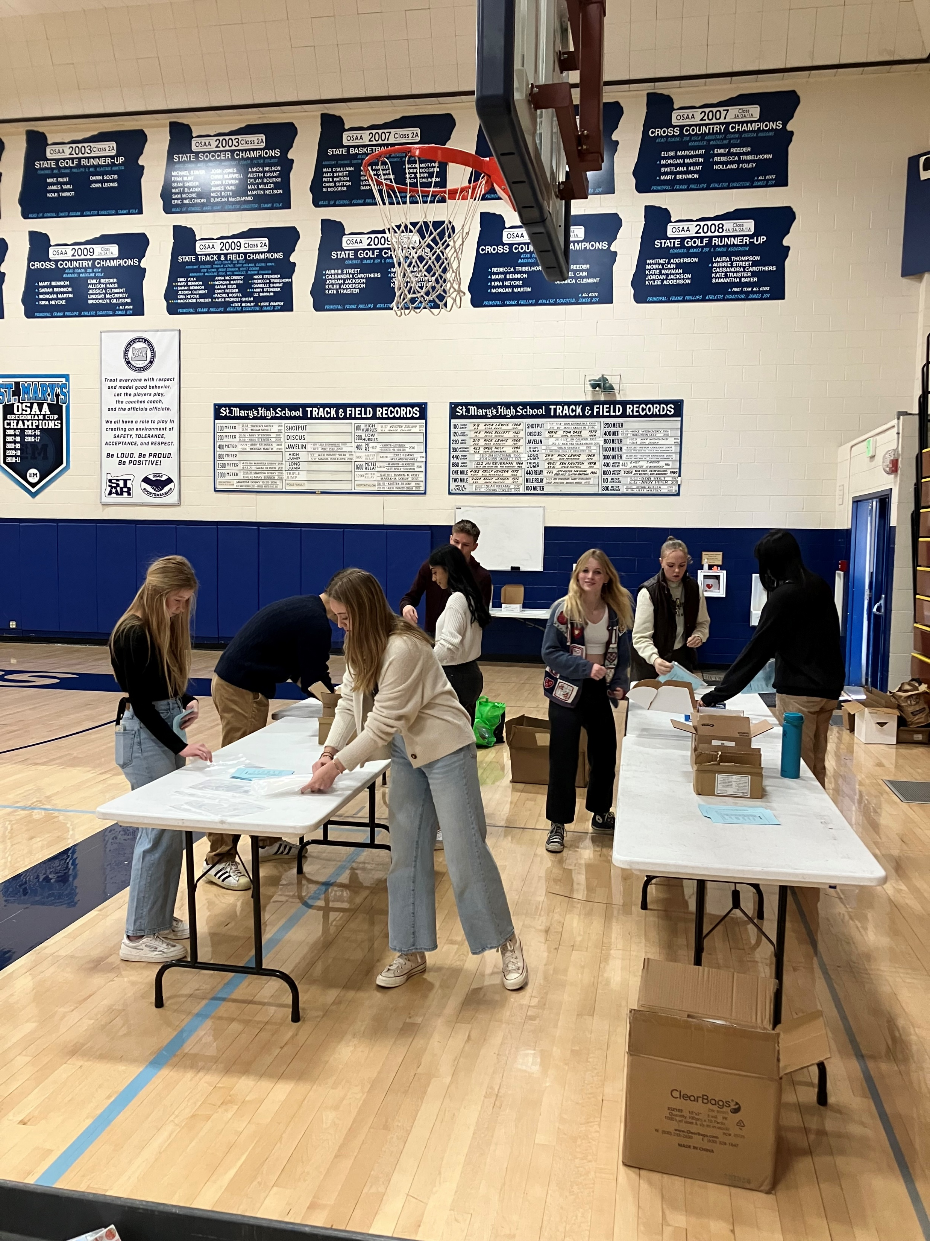
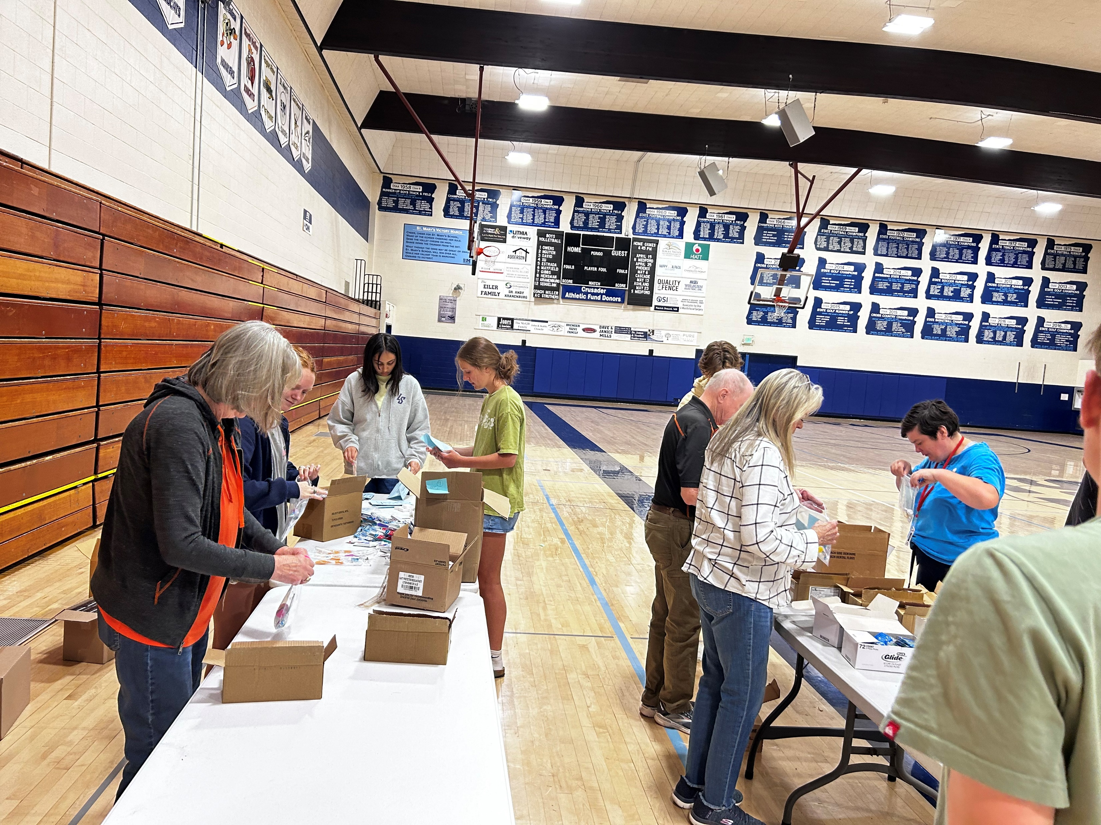
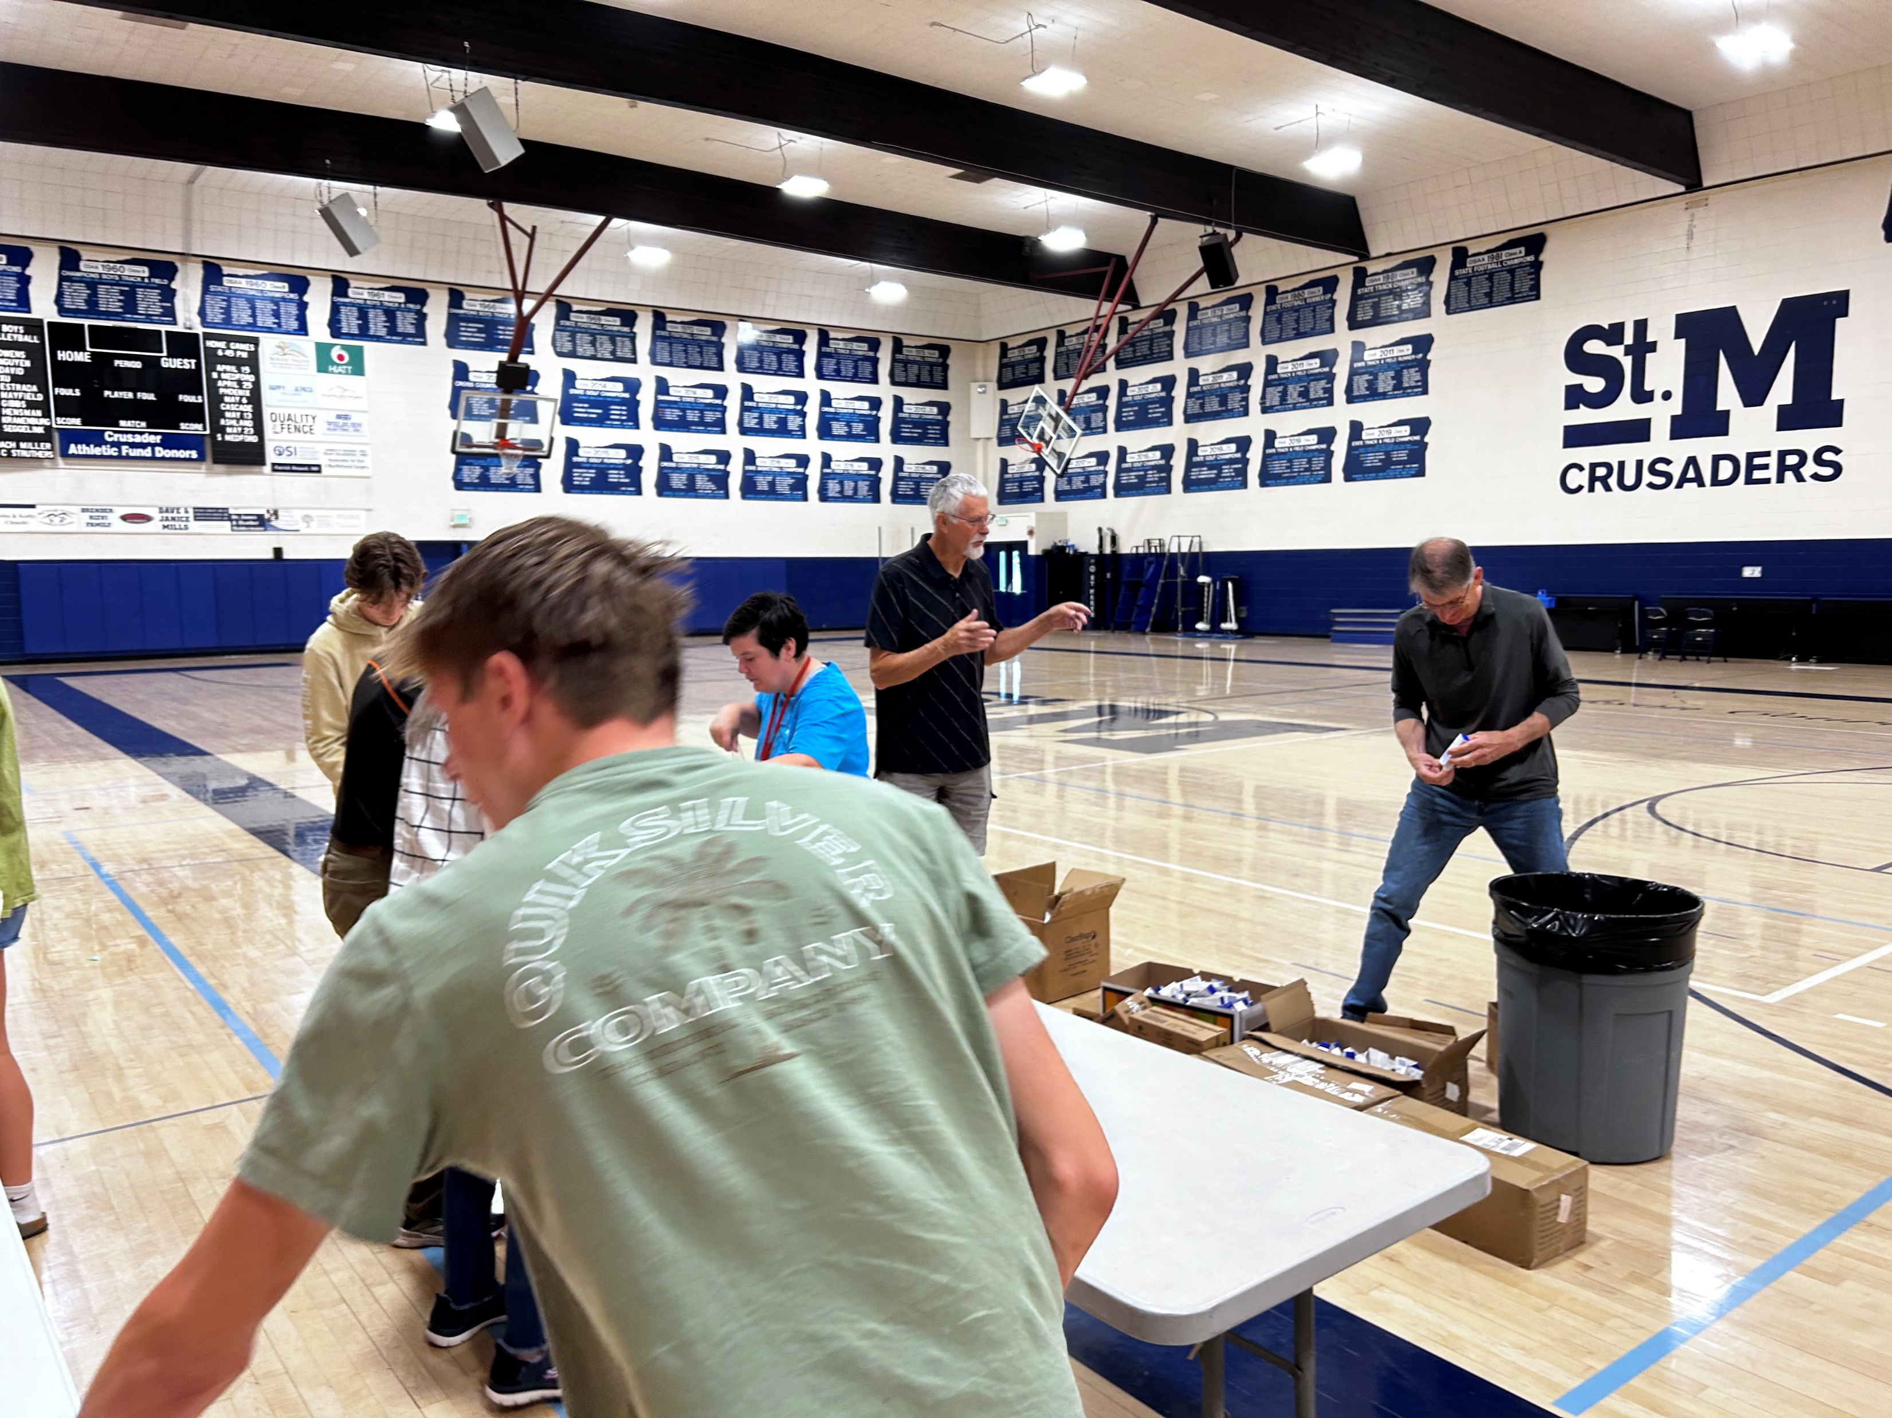
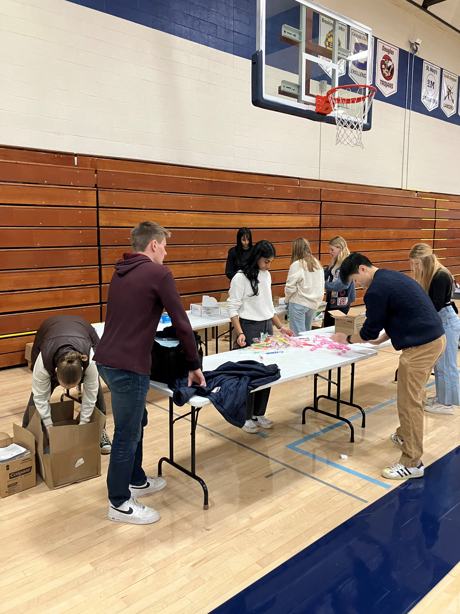
St. Mary’s
Interact
12 students
1,000 Dental kits made for Head Start & KUA Kindergarteners

Slide 13
22 Schools
Started with 483 students and ended the school year with 621 students
18,754 bags delivered = 112,524 meals and 112,524 snacks.
13 MRR volunteers helped
Rogue
Powerpack

Slide 14
Peanut Butter
Project
600 packages to KUA for winter break snacks
$5,300
20 MRR Members Volunteered

Slide 15
4-Way Test
Speech Contest
5 High School students
$525 in prizes at Club level
$7,000 in prizes at District level
MRR student Madelena Batista won 1st place at
District ($3500)

Slide 16
Student
Recognition
25 outstanding students recognized
$50 gift certificate given to each

Slide 17
Youth
Exchange
Akinori (Aki) Oka from Japan
(incoming student is
Nathalya de Castro Dobrowalski from Brazil )
Notes:
Aki is on his final trip in the US
Nathalya should be arriving in August

Slide 18
Bob Newland
Track Meet
Hundreds of students
17 events
12 schools
12 MRR member volunteers
Notes:
Return of

Slide 19
Tiger Den
At Innovation Academy:
110 student supported with basic needs - food, clothing, feminine hygiene, school supplies
$2,000 budget, plus donations from Club members
Notes:
Moved to IA

Slide 20
DPIL
Dolly Parton Imagination Library
1,311 kids registered through MRR – 49% of those eligible
3,781 total kids registered in Jackson County
>40,300 books gifted to children
Total Expenses to date = $101, 870

Slide 21
Scholarships
$175,000 given this year
17 new students
44 total students
$3.9 million in assets
Notes:
To support continuing scholarships

Slide 22
Candyland
More than 3,000 attendees
$20,000 from MRR
65 MRR volunteers giving over 250 hours
Notes:
Winter in
not only the day of but making all those Decorations . . . Committed to making more as the venue is expanding to the Expo so look for opportunities to hone your crafting skills again

Slide 23
Children’s
Festival
Almost 10,000 people attended.
MRR sets up & tears down.
16 MRR volunteers helped
Notes:
Now is the time to sign up to help this year Friday, July 13th to set up in the morning and Monday, July 15th to tear down in the afternoon. See Andy Batzer

Slide 24
RYLA
Rotary Youth Leadership Award – June 18-23 at Grove Camp in Dorena OR
2 Students – Piper Ravassipour & Dawson Murphy
(hear from them at the meeting on July 24th)

Slide 25
Fellowship
19 MRR events with tons of participation
2 United Rotary Clubs of Southern Oregon events –
Whiskey Wine Tasting & Trivia Night
4 more Summer events planned – register now!
Plus return of Friday Happy Hour (4:30 at Gold Rush Brewing)

Slide 26
Couldn’t have done it without you . . .
Committee
Chairs
39 Chairs – plus co-chairs
Board
Ian Foster, Paul Christy, Rachel Torres, Cheryl Dyer, Natalie Hansen, Tim Chesley, Gina Clyburn, Debbie Graunke, Joy Marshall, Emma Nelson, George Prokop, & Kevin Shahalami
Council
Pat Barry, Ian Foster, Carol Fischer, Eric Hodnett, Jeanne Stallman, & Roger Stokes

Slide 27
Notes:
Thank you for the opportunity to serve as your President this year. It’s been an honor and a privilege. As most of you know my big goal was to not derail the train and I think I successfully accomplished that. At this time, If we could have each of the past presidents line up, George has a microphone and the gavel, we’ll take a moment to hear what was something significant that happened during each of their year’s as President. Take it away George.

